Slide 1
Anglian Water and the Role of the Alliances 09th November 2017 David Ward, Director of the Integrated Maintenance and Repair Alliance

Slide 2
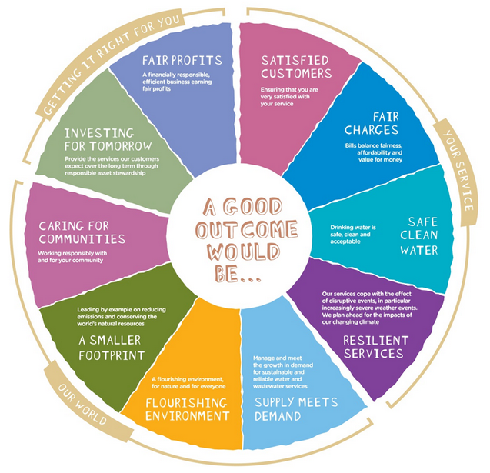
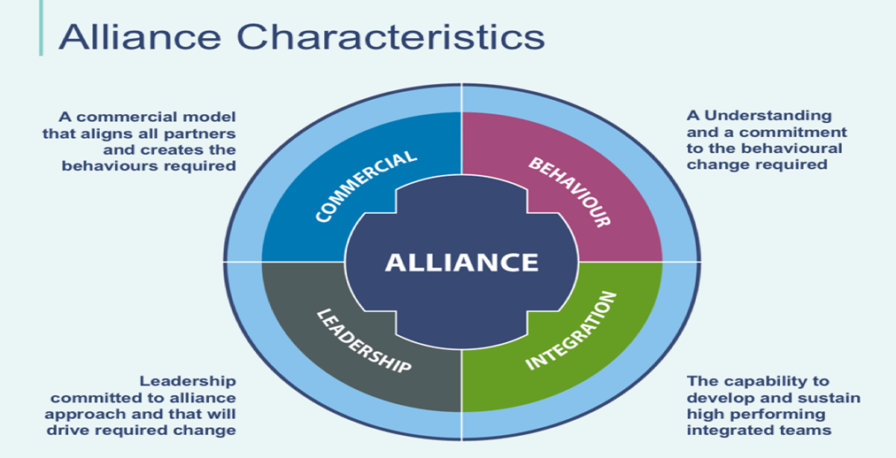
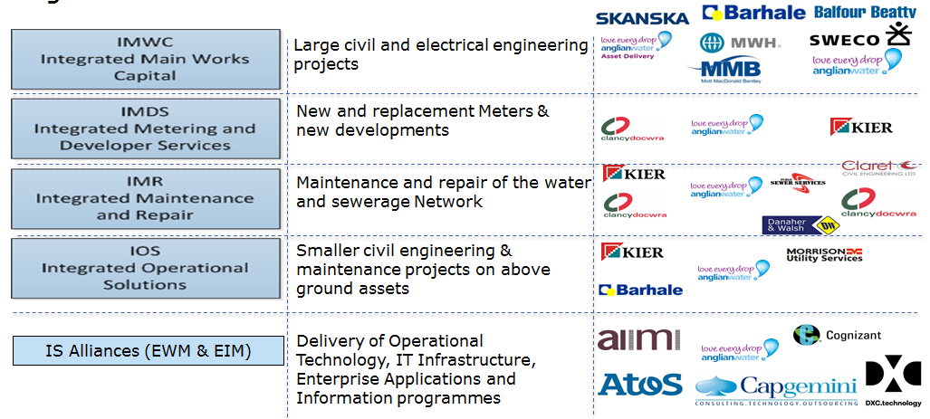
Today – Anglian Water’s approach to alliancing
AWS Context - why consider alliancing?
What is Alliancing and their characteristics?
How are AWS Alliances Structured?
Behaviours and expectations
Benefits of Alliancing
Collaborating for a better outcome

Slide 3
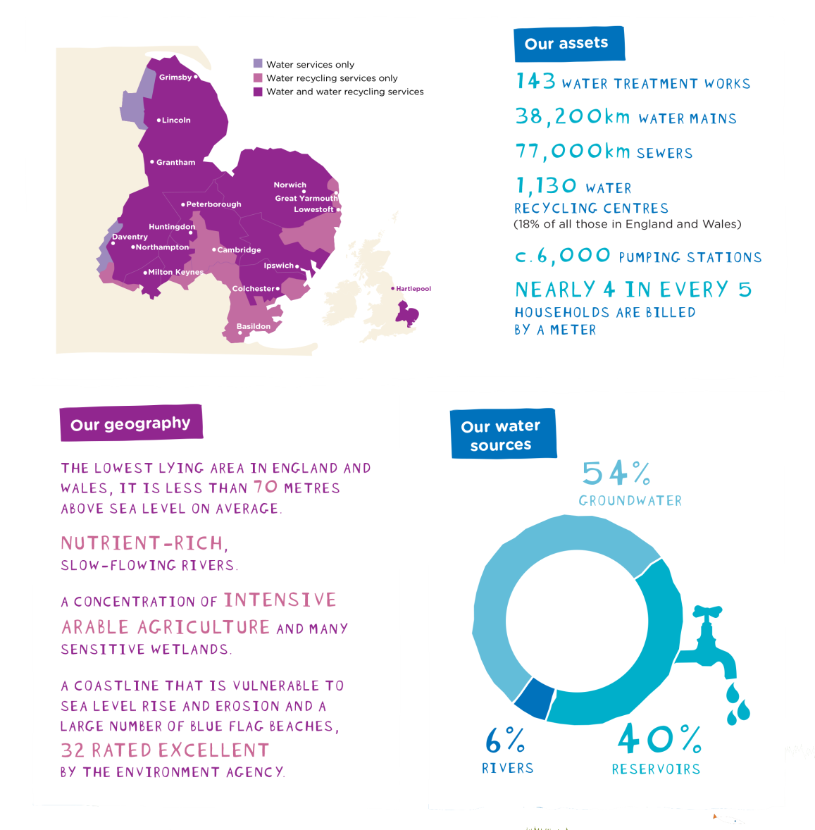
AWS Context

Slide 4
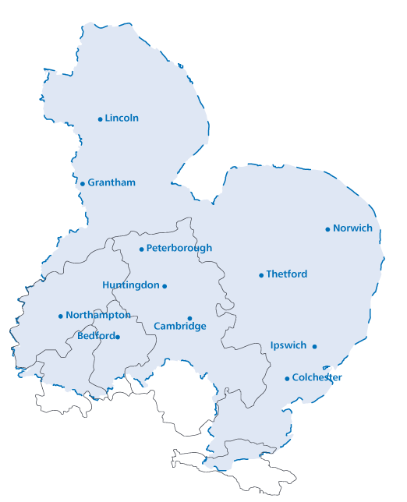
Why? Our vulnerable region
28% of the region is below sea level
demand for water will rise but available water won’t
25% of the nation’s cereal crop is grown here in East Anglia and 75% of the nation’s shellfish industry is located on the East Coast
population is expected to rise – around 1m homes to be built in the next 25 years
as a low-lying region there is a high use of energy to pump water around the region
it is the driest region in the UK
Climate change impacts and uncertainty
Notes:
Our region is vulnerable and subject to some serious challenges.
Use the information on the slides

Slide 5
Our Customer outcomes
Notes:
It was through customer consultation as part of AMP6 business planning, that our customers told us what mattered to them.
You’ll understand by reading those 10 outcomes, that SMART Water networks have a huge part to play in achieving them for our customers.

Slide 6
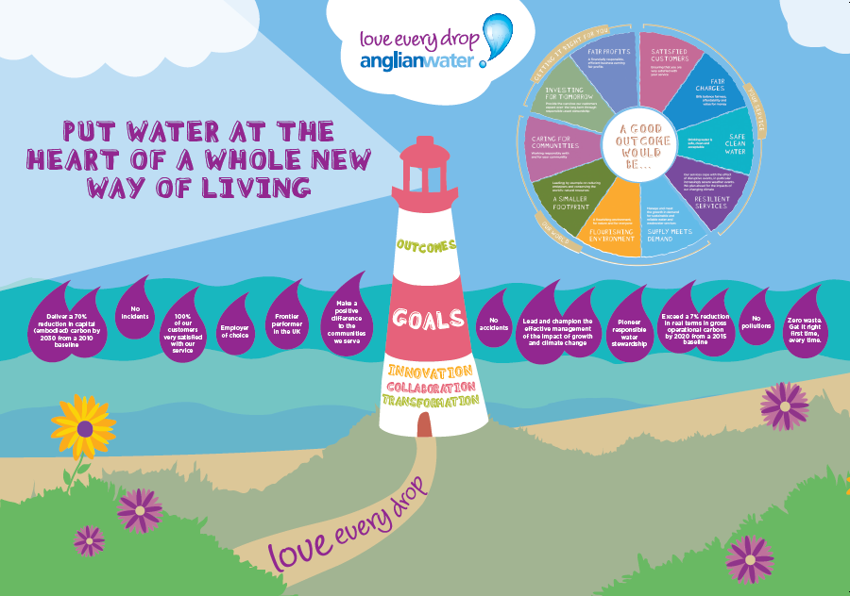
Our goals
Notes:
Its because we have such a vulnerable region that we needed to:-
Put Water at the Heart of a Whole New Way of Living
By understanding what good outcomes for our customers would be, setting stretching goals to deliver those outcomes and finally
Ensure that our strategies, behaviour and delivery demonstrate that we Love Every Drop

Slide 7
Time to think differently
Notes:
So the scene is set for us to think differently, take a new approach to the way Anglian Water uses its network.

Slide 8
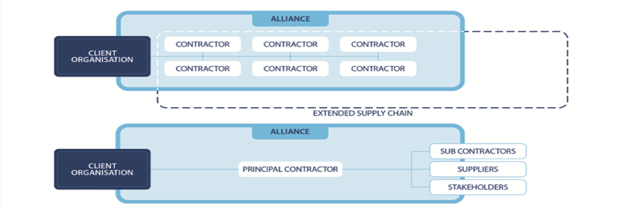
An Alliance is…
“Alliancing is a form of long term partnering on a project [or programme] in which a financial incentive scheme links the rewards of each other alliance members to agreed overall outcomes” European Construction Institute

Slide 9
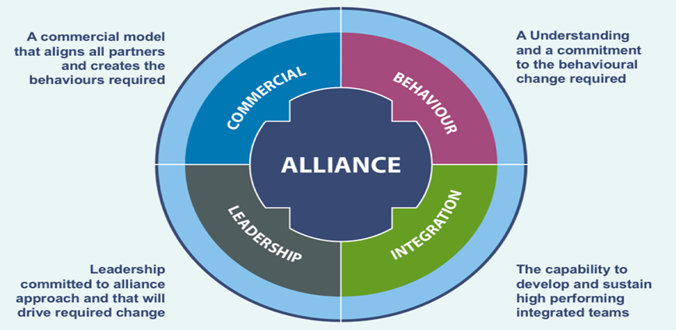
Alliance characteristics

Slide 10
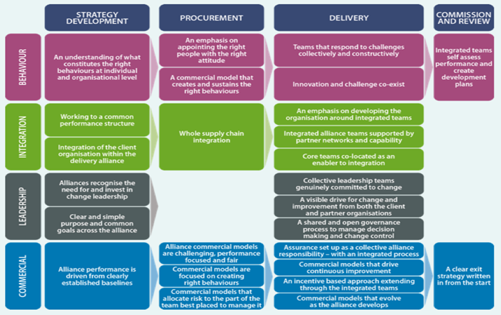
Alliance characteristics

Slide 11
AMP 6 Alliancing Principles
Collaboration
Shared Risk and Rewards
Joint Target Cost including AWS costs
Best for task or outcome
No blame/no dispute culture
Innovation fundamental
Integration
Joint Delivery Team
Best for Task
Co-Location
Relational Contracting
Flexibility
15 years
Commercial
Reward through out-performance
Performance Pool
Good Faith
Value for money
Open Book
Alignment
Aspire over time to submit joint business plans for Regulator

Slide 12
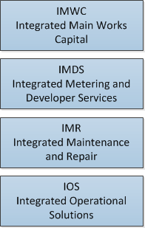
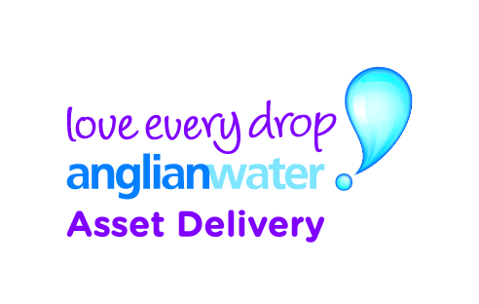
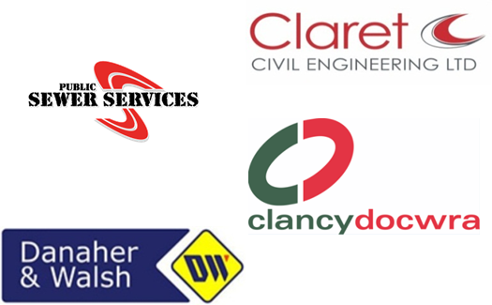
Six New Alliances, Nineteen Partners - a new way of working together
Large civil and electrical engineering projects
New and replacement Meters &
new developments
Maintenance and repair of the water and sewerage Network
Smaller civil engineering & maintenance projects on above ground assets
IS Alliances (EWM & EIM)
Delivery of Operational Technology, IT Infrastructure, Enterprise Applications and Information programmes
Notes:
Reminder of four delivery routes. Then intro video.

Slide 13
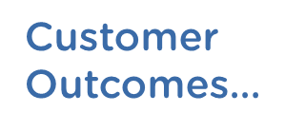
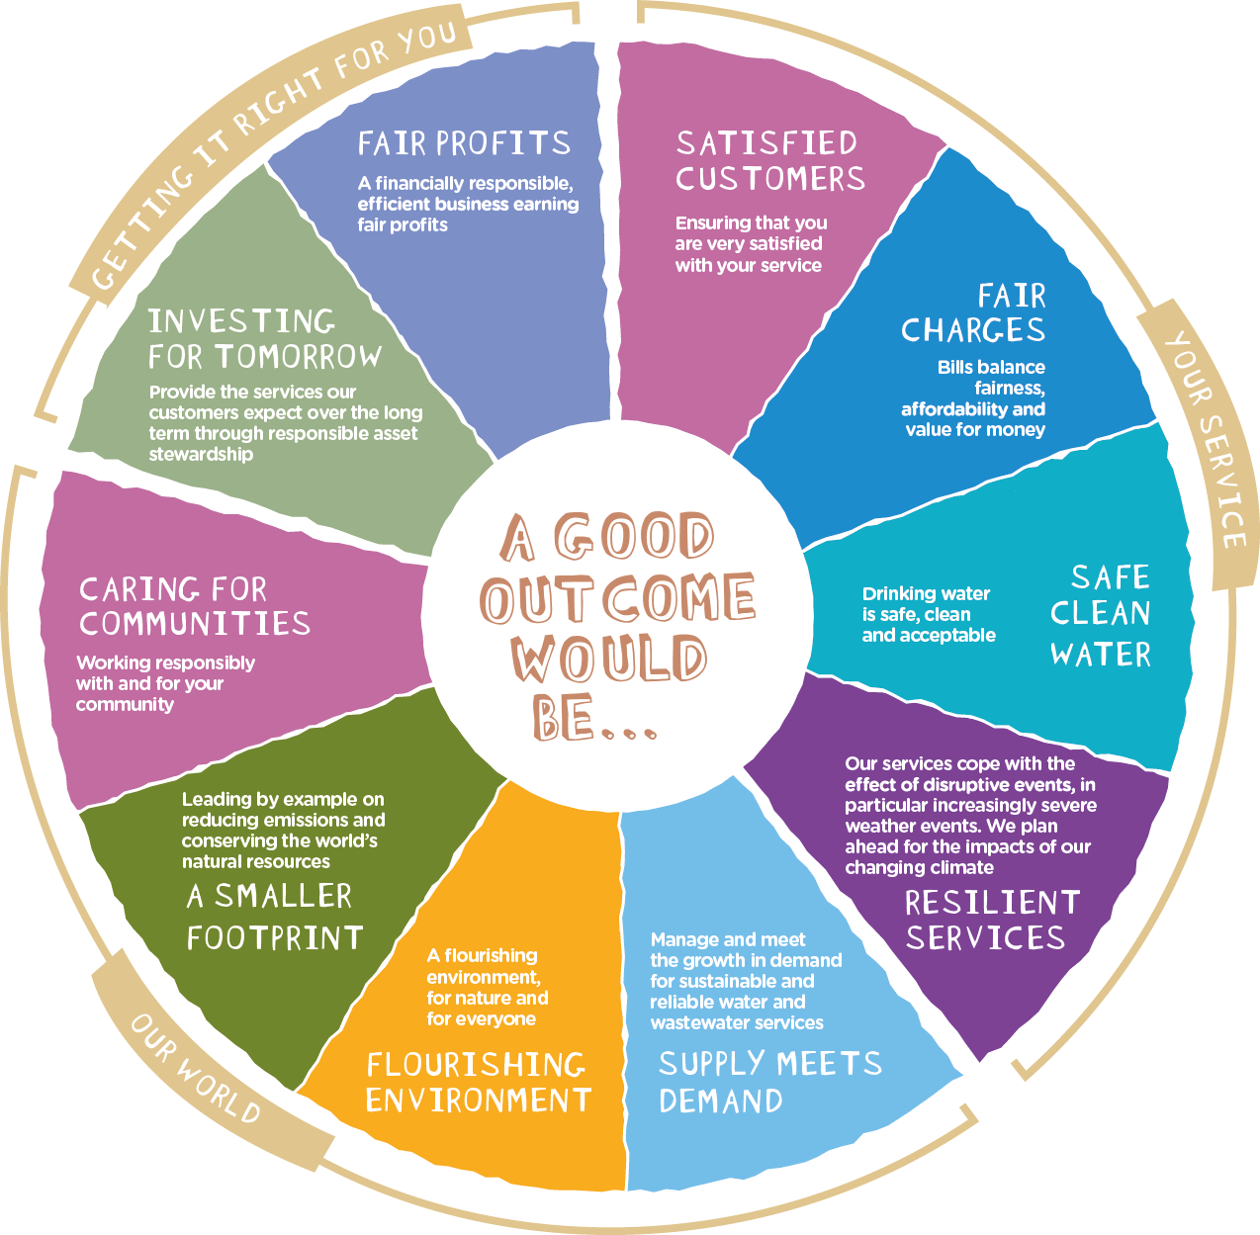
Creating Alignment…

Slide 14
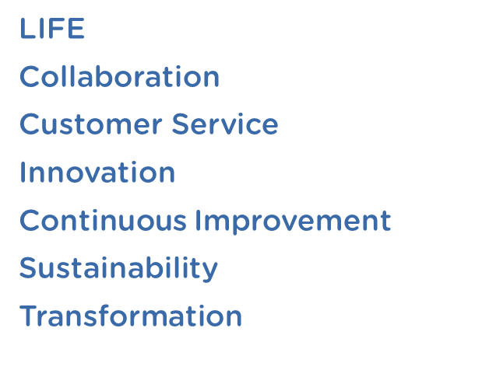
A focus on the right behaviours…

Slide 15
A smarter way of thinking
Strong Leadership and Belief
Letting go for the good of the Alliance
Develop a culture of continuous improvement
Building trust is fundamental to success
Collaborating with partners and suppliers to match problems with solutions

Slide 16
Key Challenges…
Requires different approach to procurement
Collaboration:
Not the easy option
Requires mutual dependency
Requires organisations and leaders who can:
Work differently
Manage change
Create teams
Combines strategic and project relationships

Slide 17
Key Benefits of Alliancing
collaborative teams; sharing best practice
- enables earlier partner involvement
- provides access to multiple partner capability
- open relationships, providing transparency and visibility (360 degree)
- significantly reduced interface and transaction costs
15 year framework enables;
Long Term investment in people
Flexible and evolving approach based on Client needs
Continued alignment of objectives and performance incentives

Slide 18
Collaborating for a better outcome
Notes:
Penguins – 1min 22

Slide 19
Thank you for Listening

