Slide 1
@one Alliance
Elliott Harley
Design Manager - Infrastructure

Slide 2
What are our main priorities & challenges?
Priorities:
Customer, customer, customer!
Digital Transformation
Supply Chain total integration
How can you help us achieve Anglian Water’s outcomes?
Challenges:
Utility avoidance
Digital delivery of work
Ground & surface water control
Real time network & asset management
Although on the face of it these are straightforward, the detail often gets complex.
What outcome from today?

Slide 3
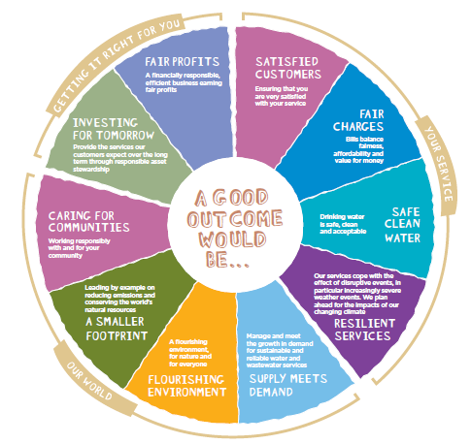
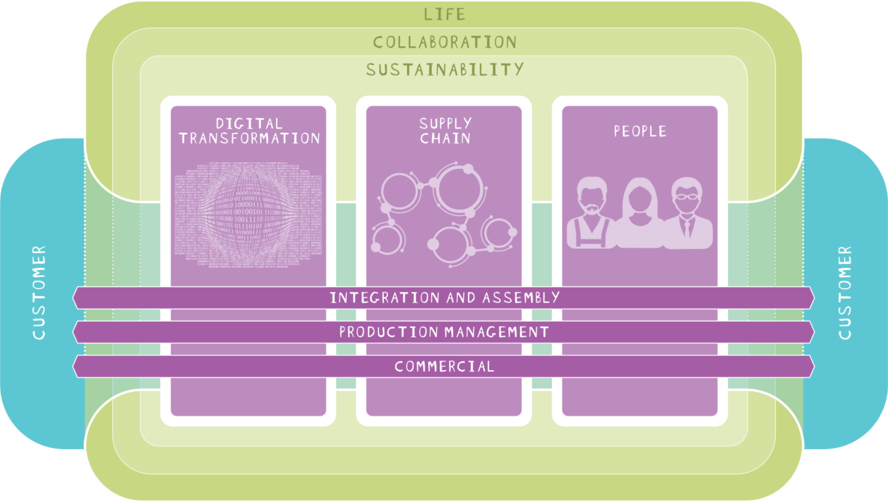

Slide 4
D&B Hierarchy
e.g. challenging
the need for
the solution
Four-stage process to remove embodied carbon at the project planning stage
e.g. Innovation
e.g. Ductile Iron to
recycled Plastic
Commercial agreement on ‘outcomes’ not what we build
e.g. Lean
manufacturing

Slide 5
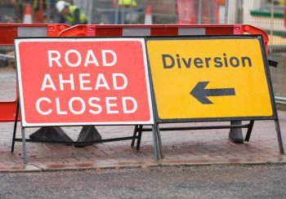
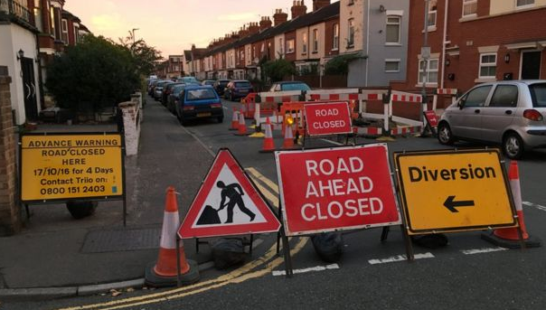
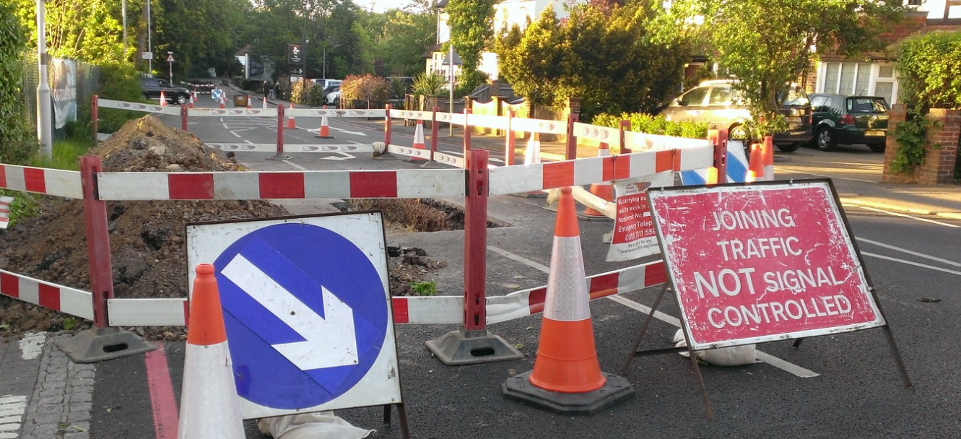
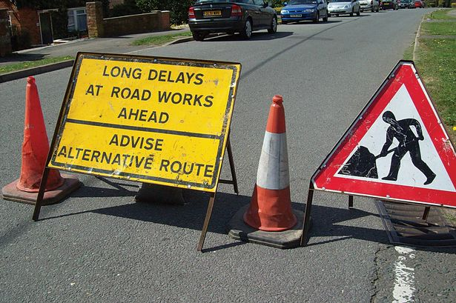
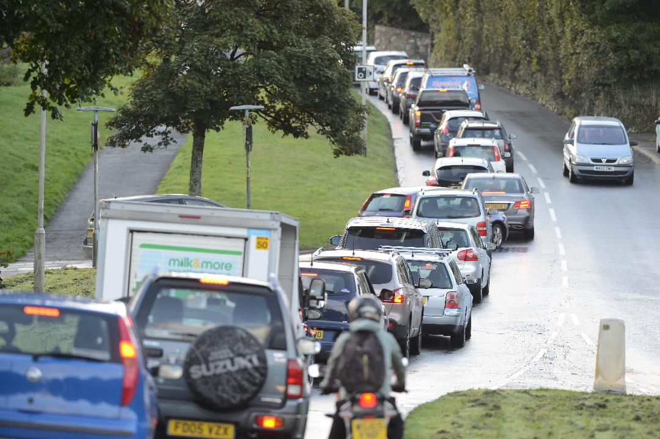
Customer – The Wrong Experience

Slide 6
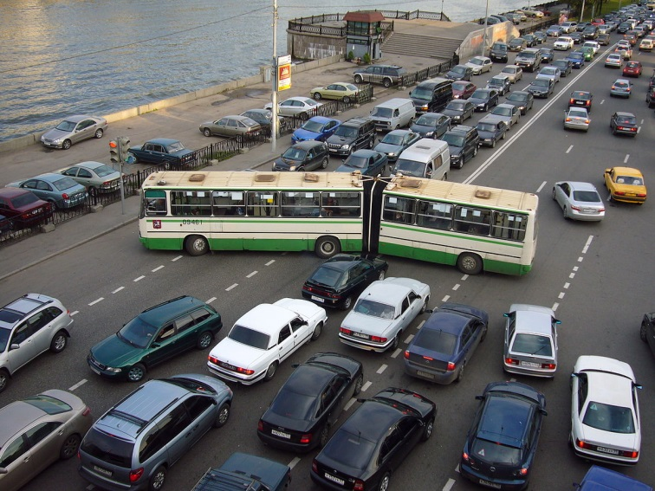
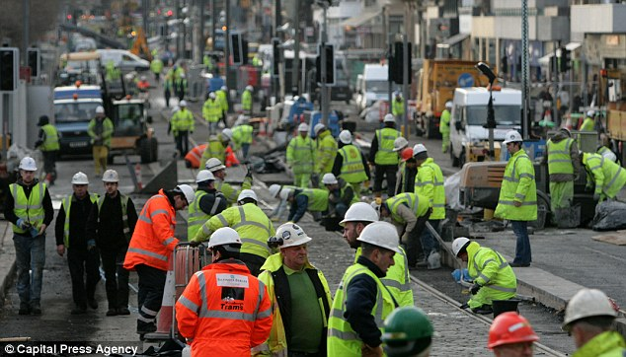
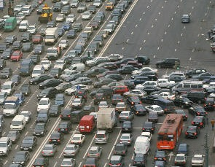
Customer – The Wrong Experience

Slide 7
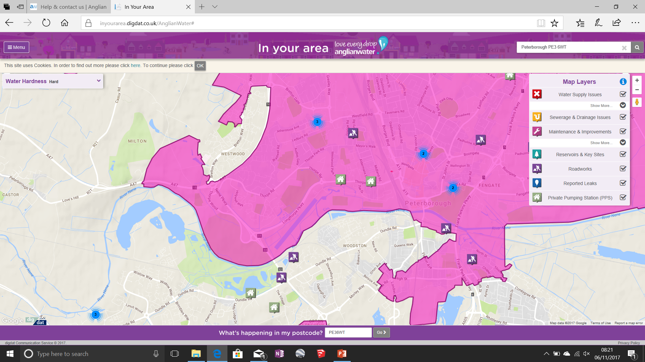
In Your Area

Slide 8
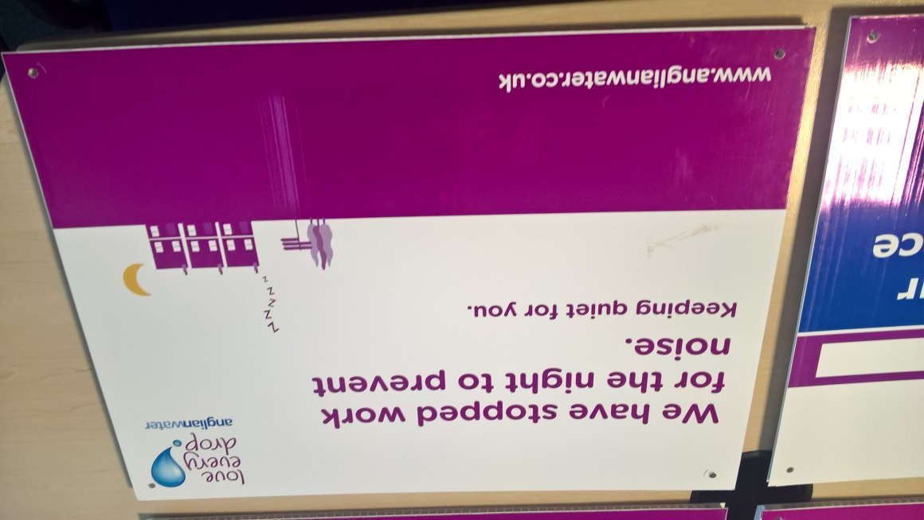
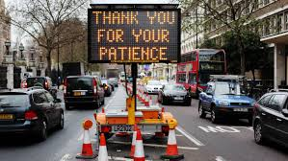
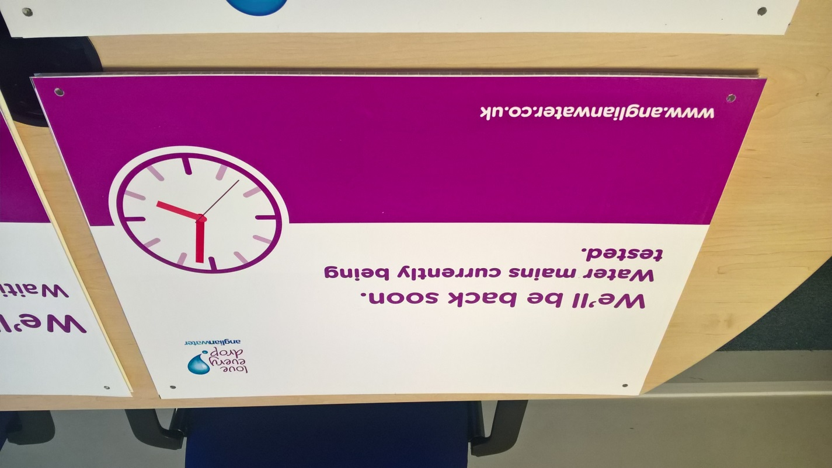
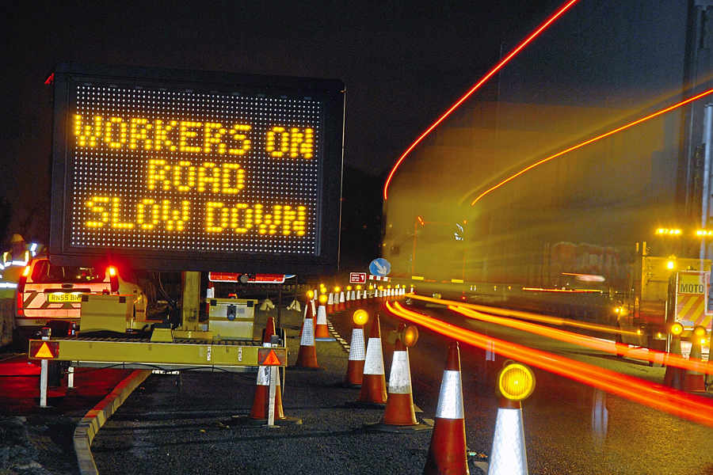
The Right Customer Experience

Slide 9
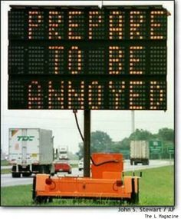
Customer Innovation:
How do we communicate with our customers now and in the future?
  Push information to mobile devices?
Mobile LED traffic display
Electronic signs on site fencing?
Lights stuck on red – a real customer irritation!

Slide 10
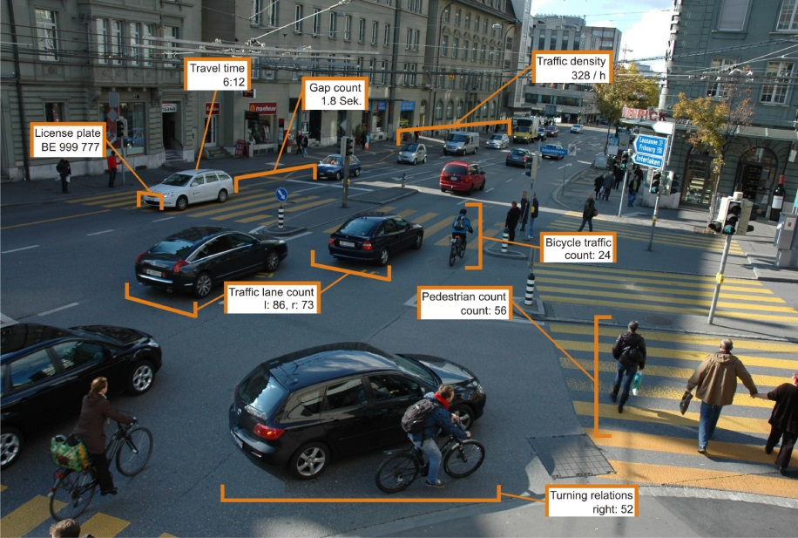
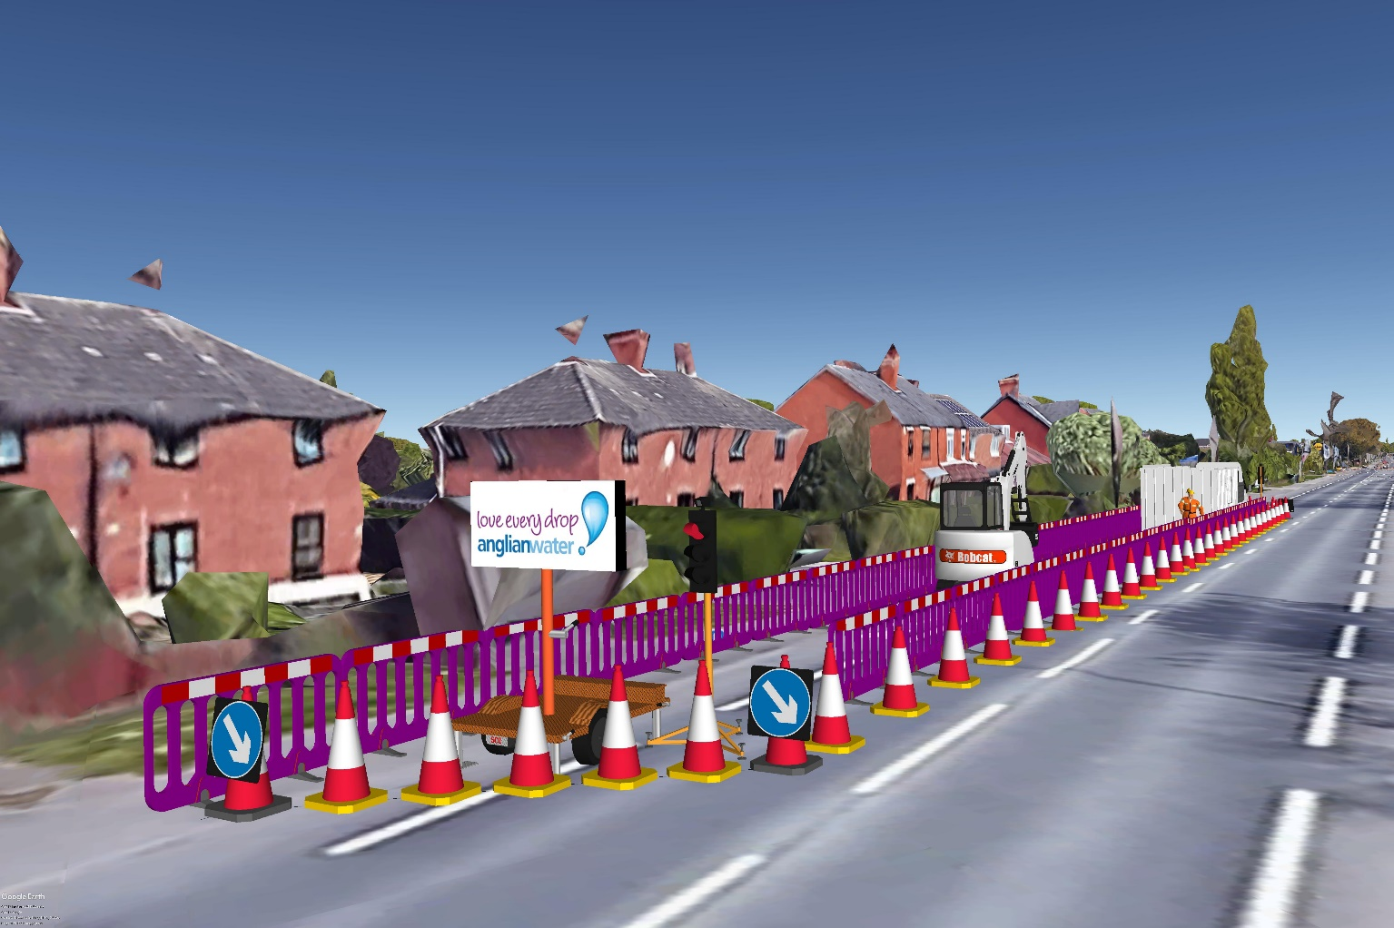
Digital Visualisation & Control of our work

Slide 11
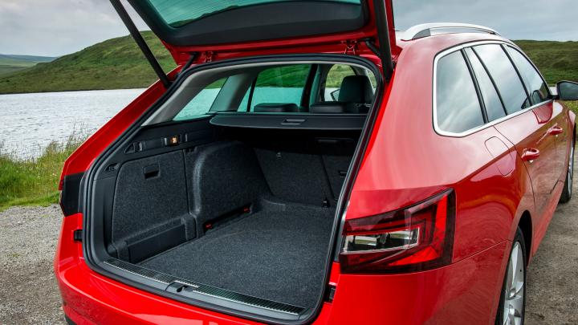
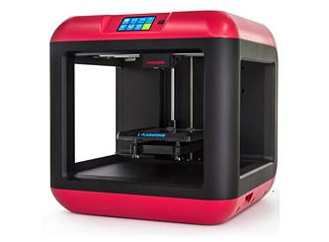
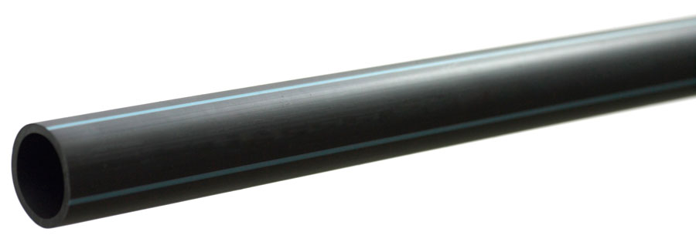
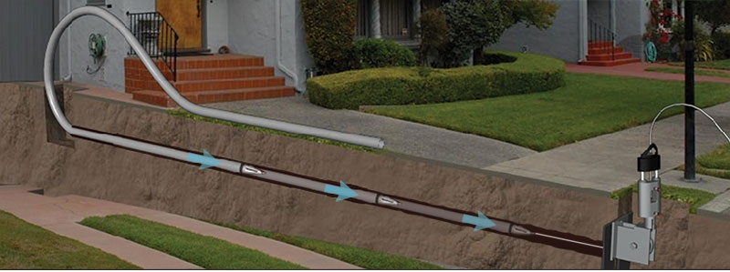
Future Technologies & Carbon Reduction:
What future technologies can help us in the future?
  How do we minimise customer disruption
  What technologies will reduce our carbon footprint

Slide 12
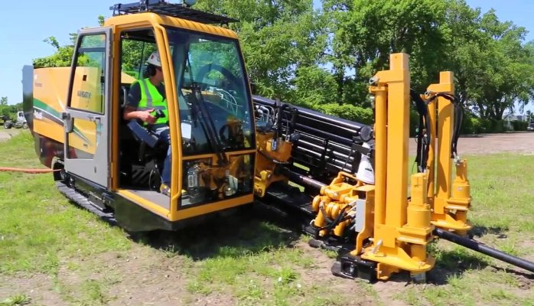
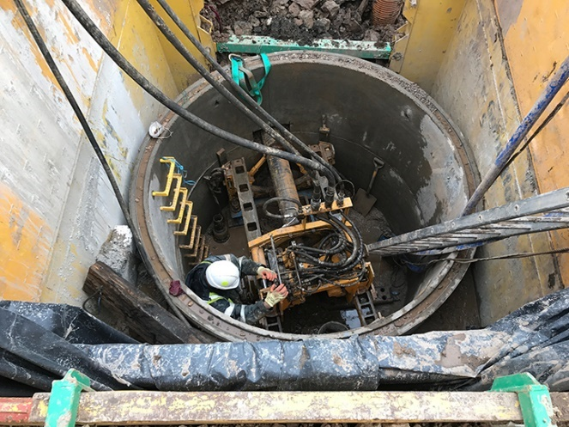
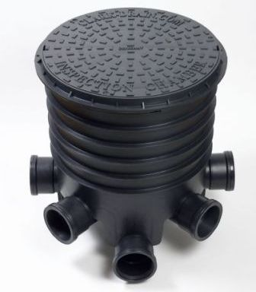
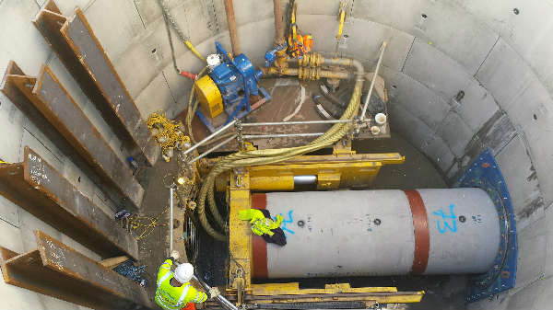
Future Technologies & Carbon Reduction:

Slide 13
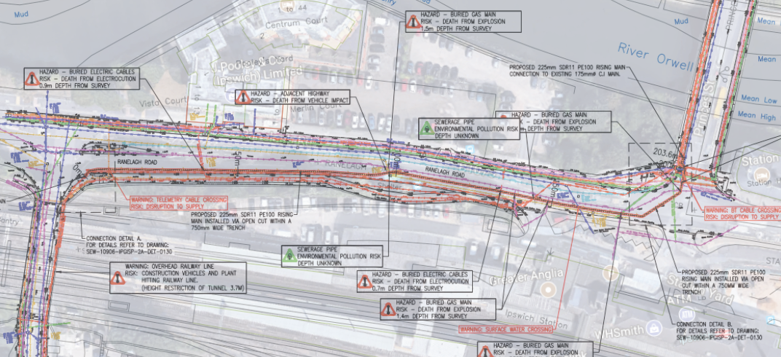
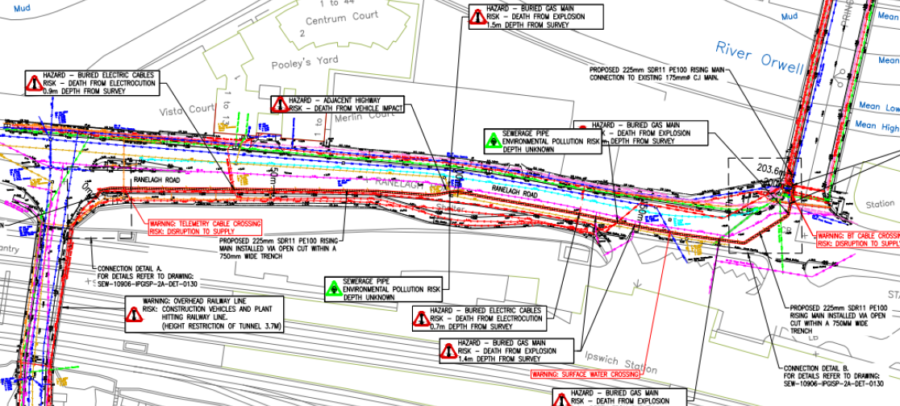
Utility Avoidance:
What is the next steps in service avoidance?

Slide 14
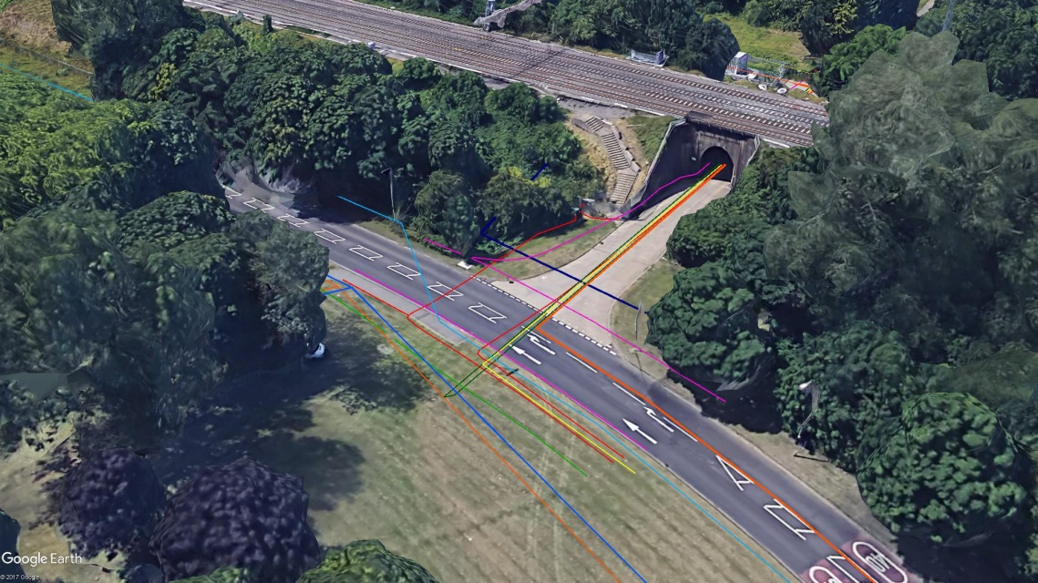
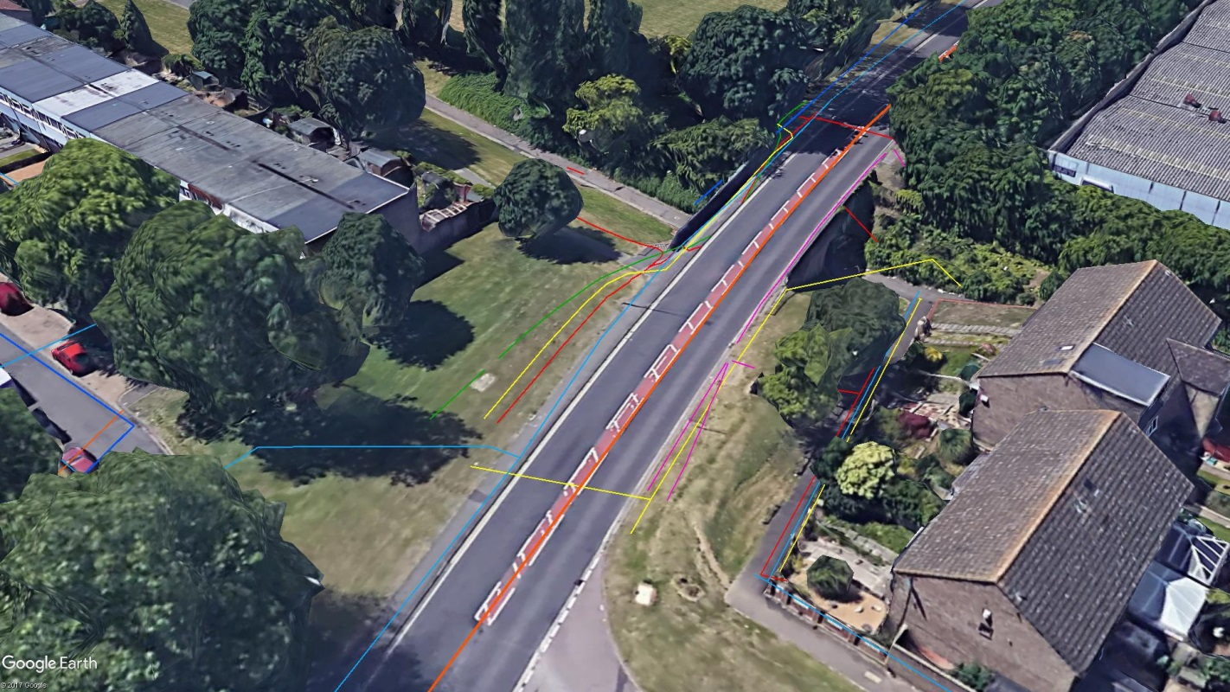
Utility Avoidance:
Digital 3D environments (GEO PLM):

Slide 15
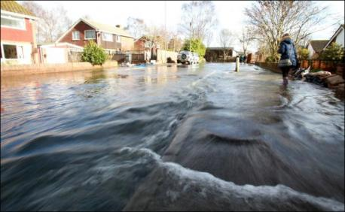
Surface & Ground Water Control:
Catchment wide problem
Pump & Treatment ££££
How do we identify surface & ground water inputs?
Existing technologies are less than accurate

Slide 16
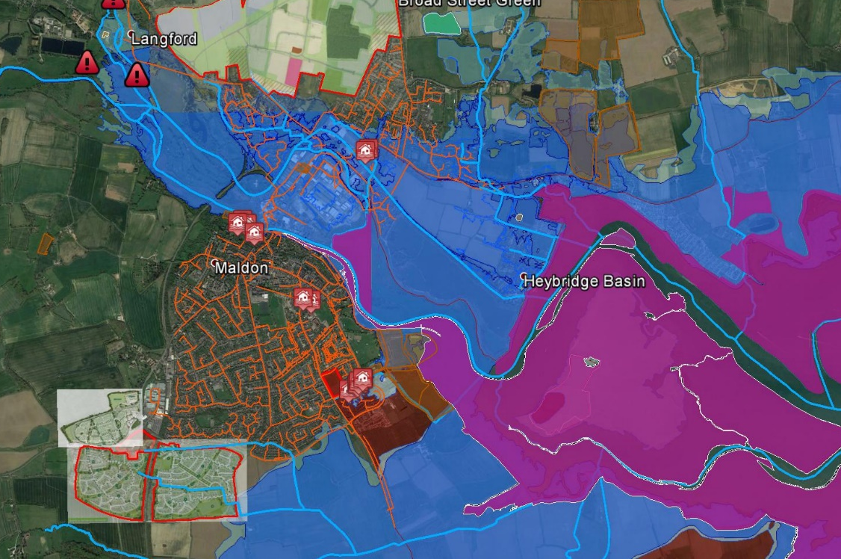
Surface & Ground Water Control:
Risk mapping, data sets
Survey equipment?
  New technologies?
  How do we better quantify flows?
What part can you play?

Slide 17
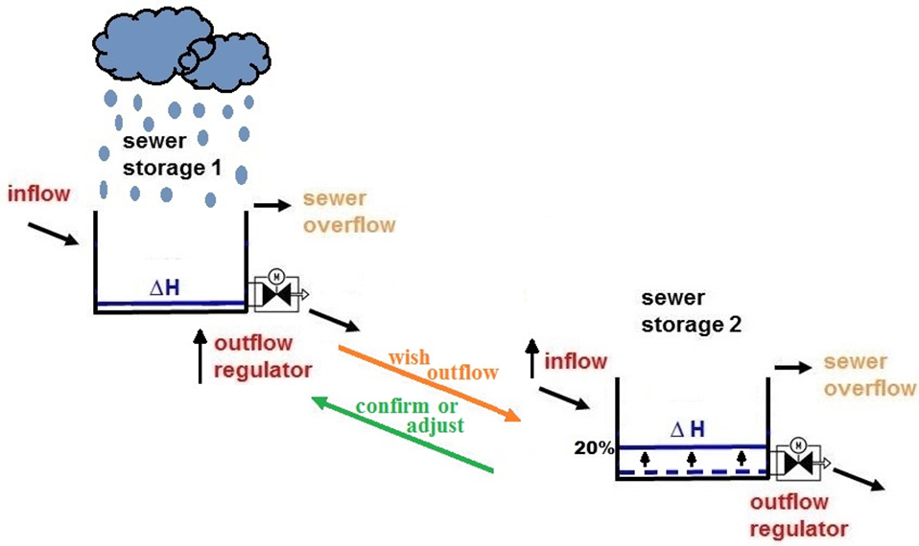
Network & Treatment Management/Control:
How do we monitor and control our networks & treatment to maximise efficiency?
How do we identify surface & ground water to reduce infiltration and treatment costs (previous slides)

Slide 18
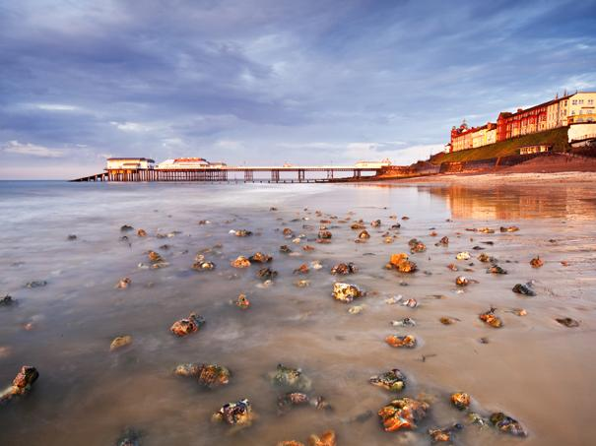
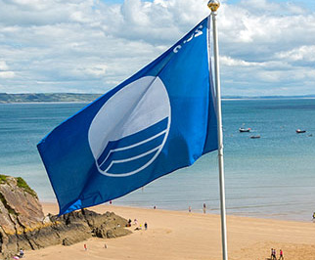
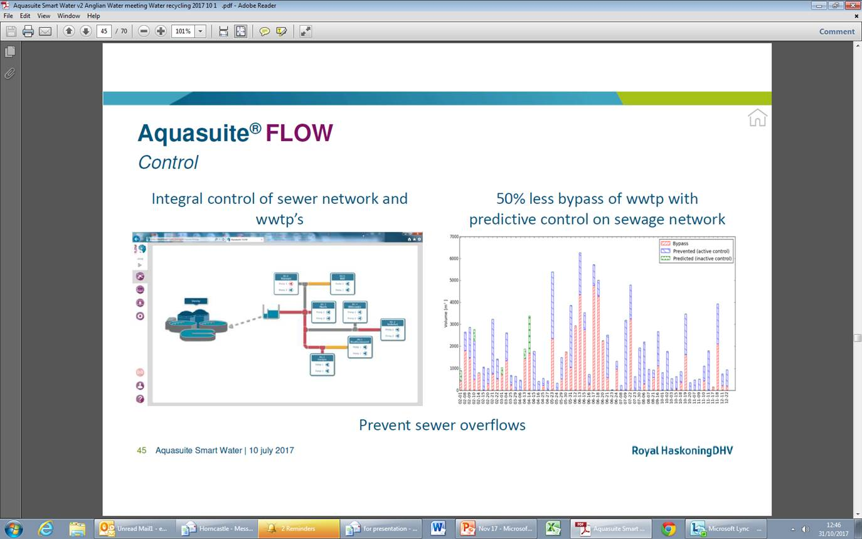
Network & Treatment Management/Control:

Slide 19

Digital Delivery in Infrastructure:

Slide 20
@one Alliance
Elliott Harley
Design Manager - Infrastructure

