Slide 1
Integrated Maintenance and Repair Water (IMR W)
09th November 2017
Presented: Jamie Worthington

Slide 2
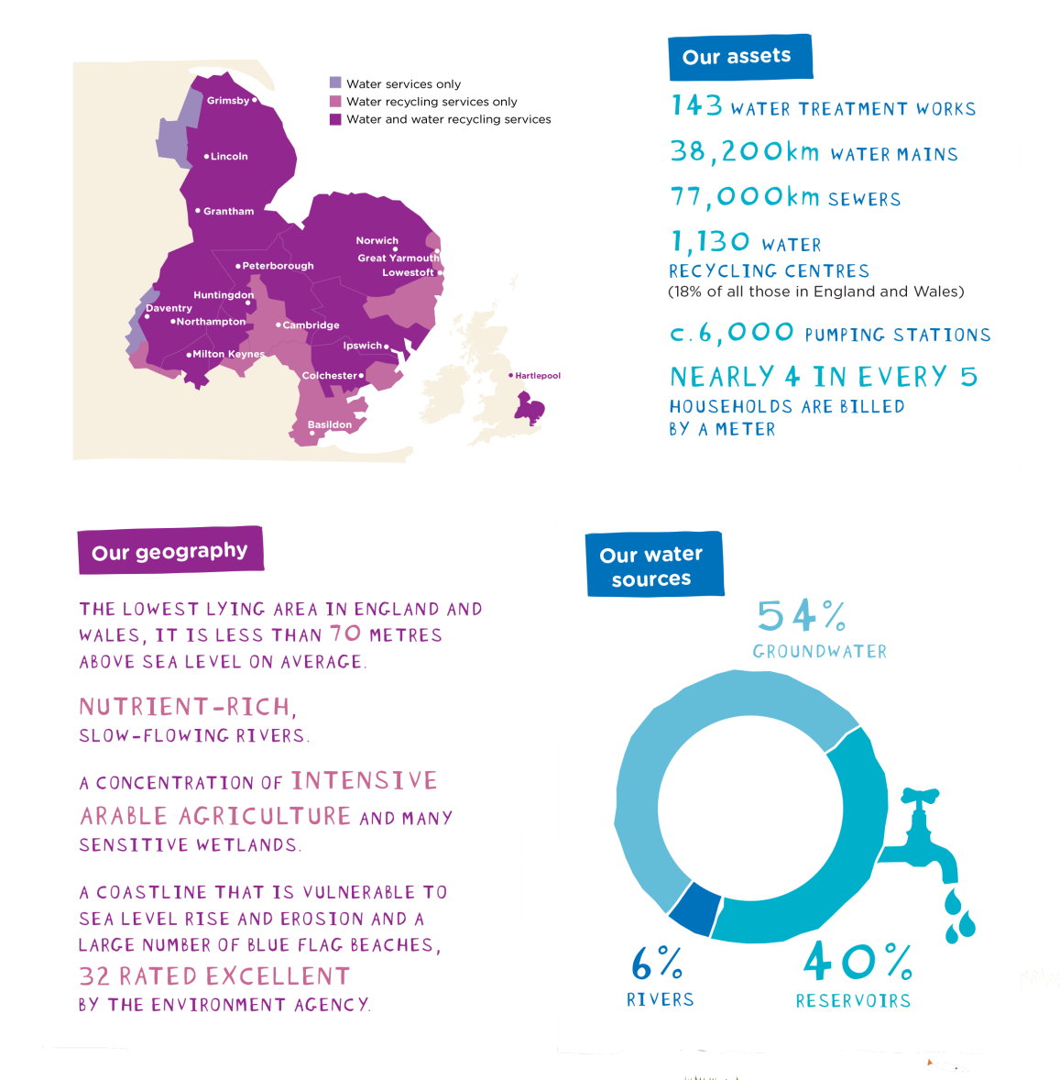
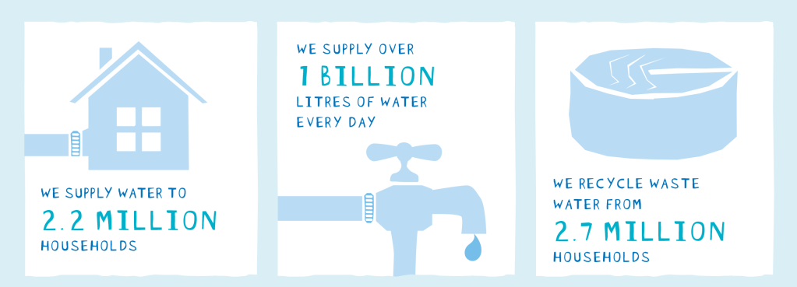

AWS Context

Slide 3
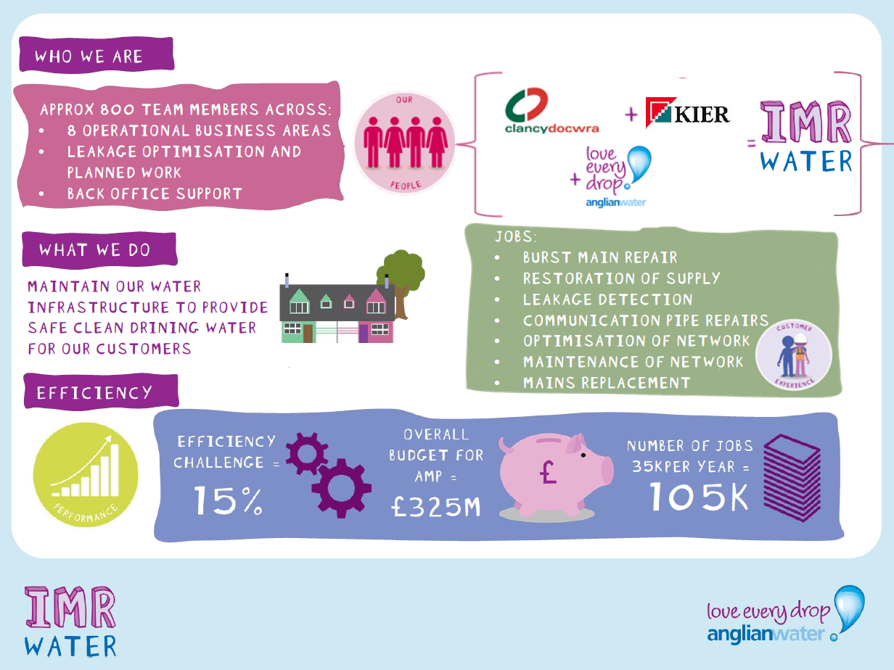

Slide 4
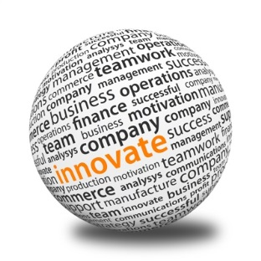



How are we approaching delivery
Clear vision/strategy
Innovate
Collaborate
Think diffently
Technology
Data
Process
People

Slide 5
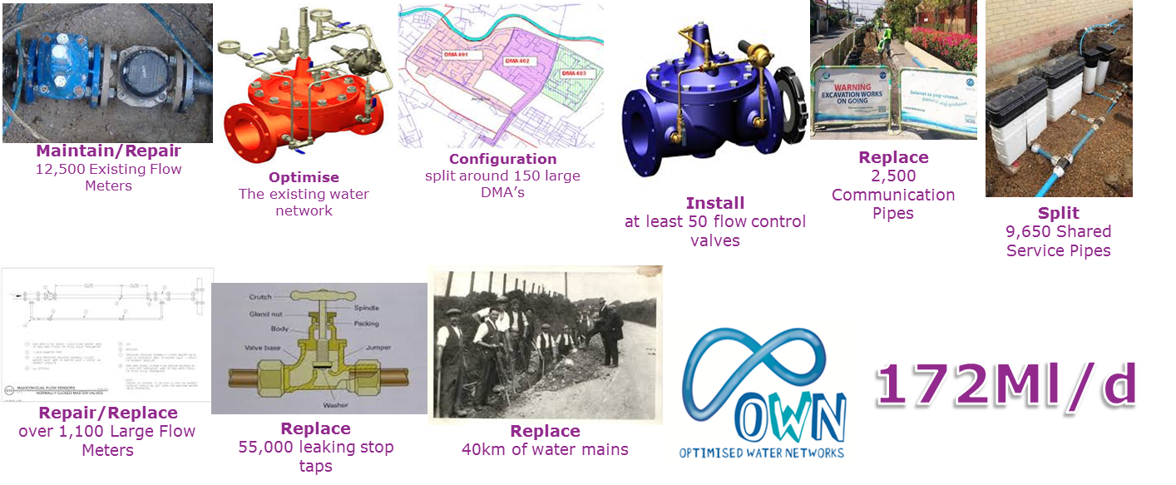
E.g. Proactive delivery targets and scope

Slide 6
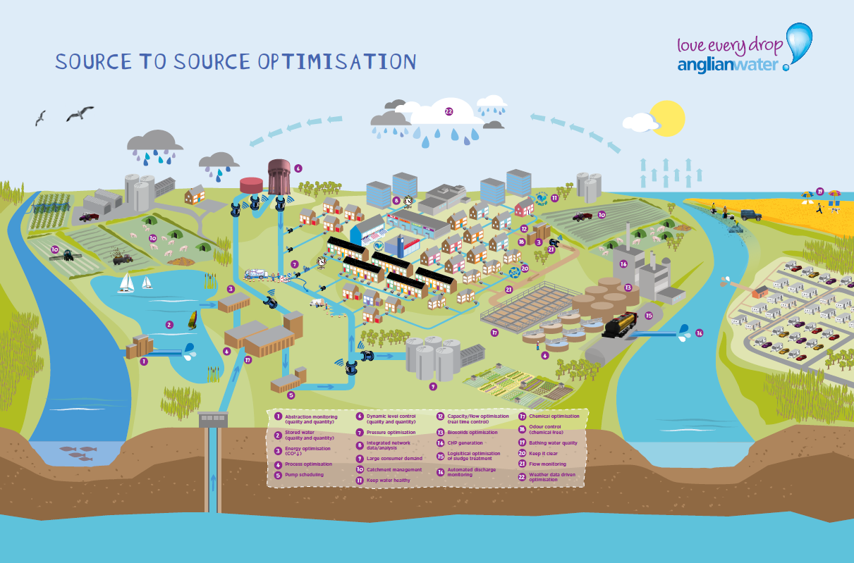
Looking beyond our current plans
Move towards a Source to Source optimisation strategy

Slide 7
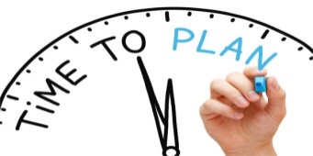
What is coming next?
2015
2017
2020
2025
AMP5
OWN
R2M
Alliance
AMP6
ODI’s
  Leakage 172 Ml/d
  I2S 12 minutes
1st in SIM
Increased Planned works
AMP7
Customer Focus
Stretch ODI’s
  Leakage
  I2S
Water Resilience
Intergenerational focus

Slide 8
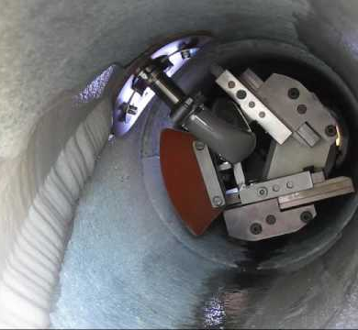
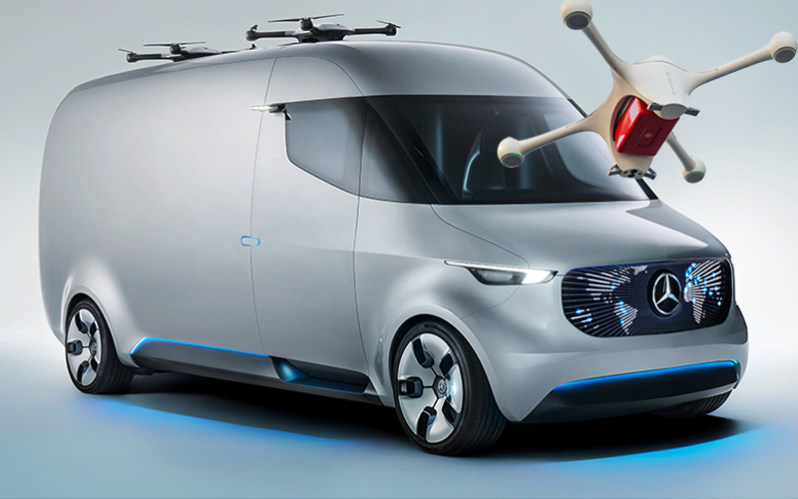

Areas of future opportunity/development
Repairing a leak without digging a hole.
(Leakage challenge)
Responding to changing world
(e.g. New Road Types)
Fully automatous teams
(Industry leading productivity)
Self Healing Pipes
(reduce bursts and proactive reapir)

Slide 9
Thank you for Listening

