Slide 1
Integrated Metering and Developer Services

Slide 2
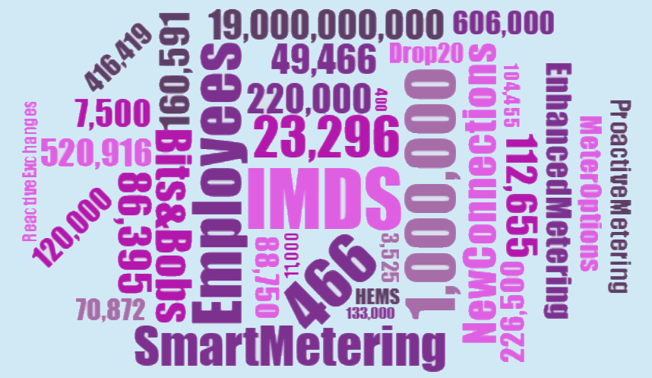

Slide 3
70,872
49,466
112,655
Meter Options
Drop by 20
New Connections
88,750
3,525
86,396
Reactive Exchanges
Selective Meters
Enhanced Meters
416,419
450,000
120,000
Proactive Exchanges
Housing Estate Mains
Bits and Bobs

Slide 4
23,296
11,000
7,500
19,000,000,000

Slide 5
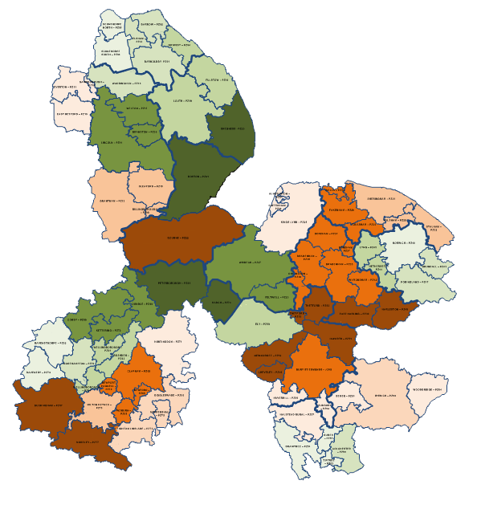
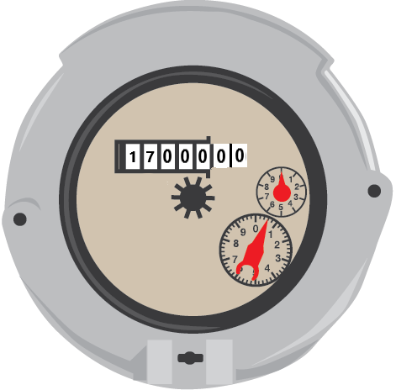
226,500
520,916
1,000,000
160,591
87%
104,455
95,000

Slide 6
466
282

