Slide 1
Waterconnect 2017
IOS
Neil Baird – Design Manager

Slide 2

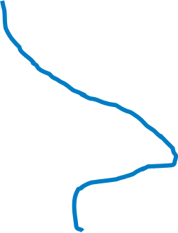

Enterprise
House Lincoln
Operational Needs
£50-£60m per year
All of the wholesale business
Clean Water
Waste Water
Infrastructure
Non-infrastructure
Energy Generation
Thorpe Wood House, Peterborough
Whitlingham, Norfolk
Great Billing, Ruthamford
Colchester, Essex

Slide 3
3,000 Jobs
Complex New Assets
Planned Improvements
Emergent needs

Slide 4
 | Water | Water Recycling | Total
Standalone - Big jobs | £4.1m | £11.1m | £15.2m
Job Parcels - As needs arise | £5.0m | £16.6m | £21.6m
Project Parcels - Pre-planned | £8.7m | £13.4m | £22.1m
Total | £17.8m | £41.1m | £58.9m

Slide 5
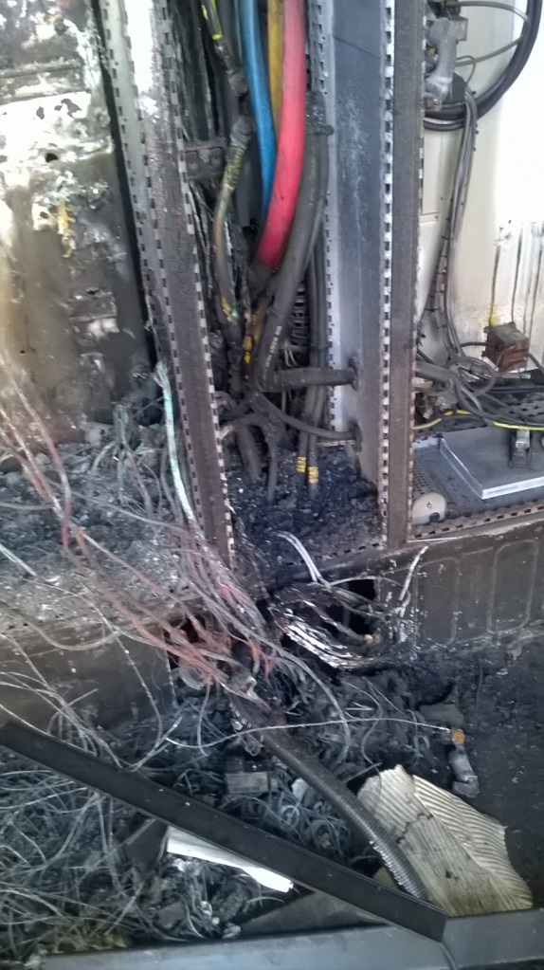
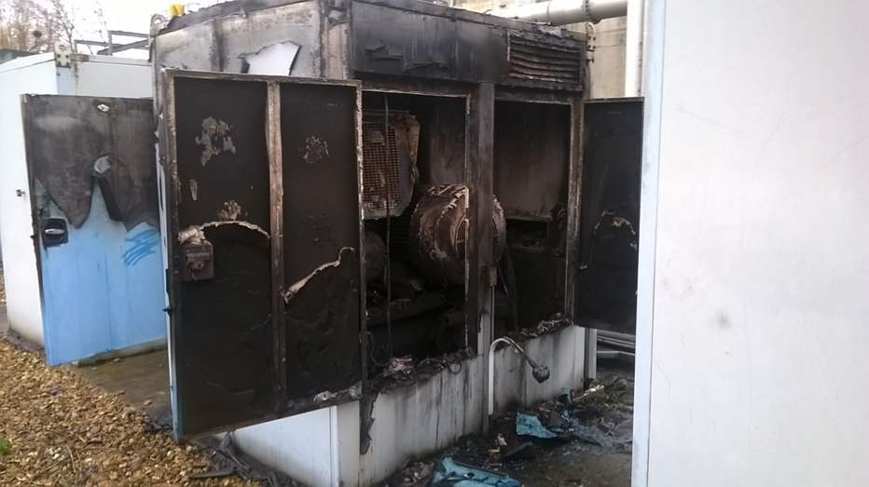
What does an emergent need look like?

Slide 6
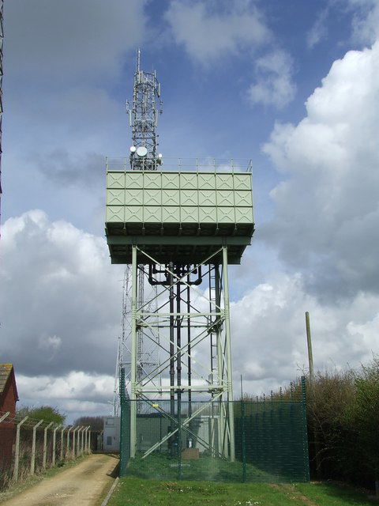
What does an emergent need look like?

Slide 7
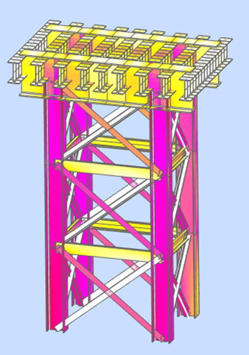
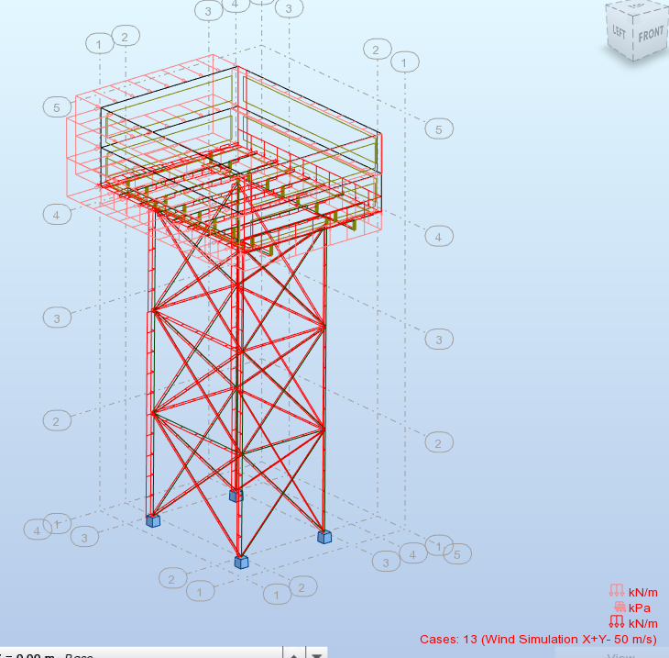
What does an emergent need look like?

Slide 8
What does planned work look like?

Slide 9
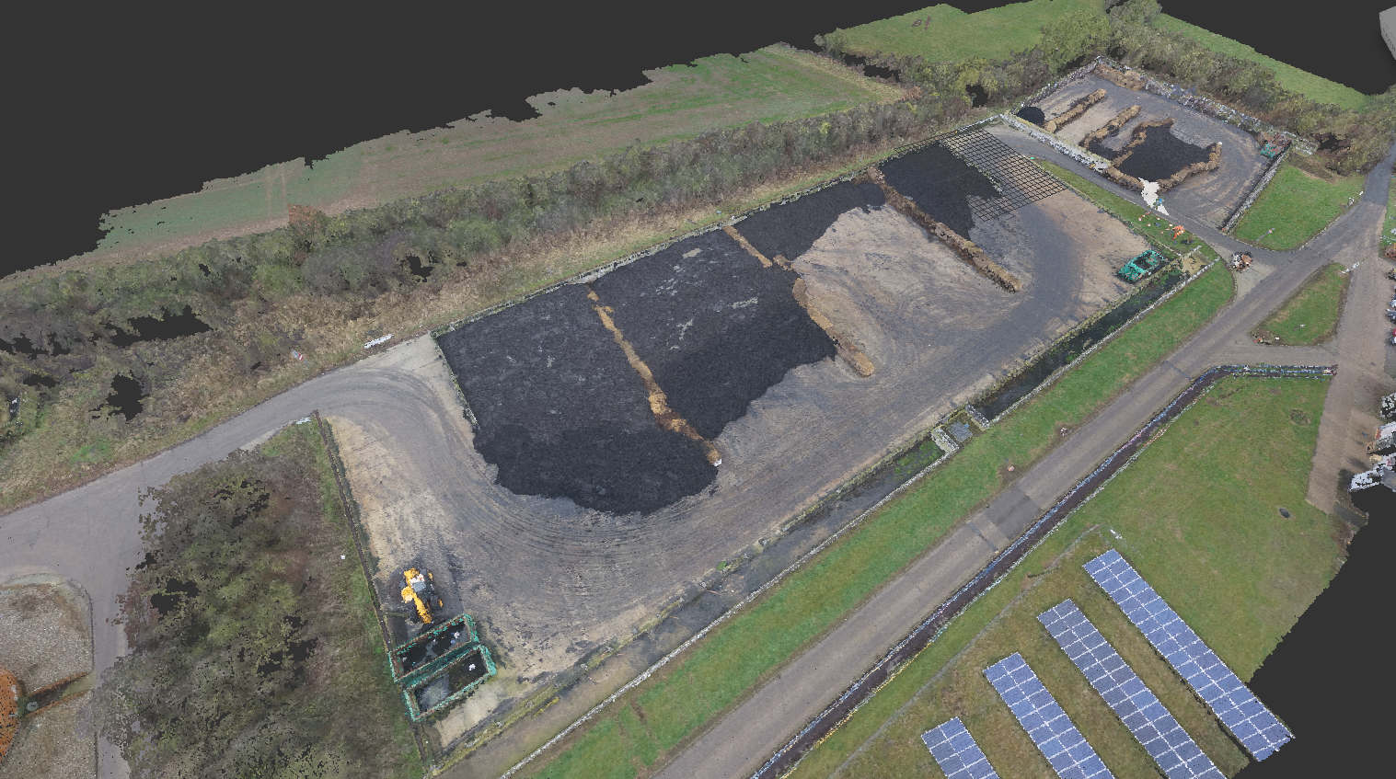
What does planned work look like?

Slide 10
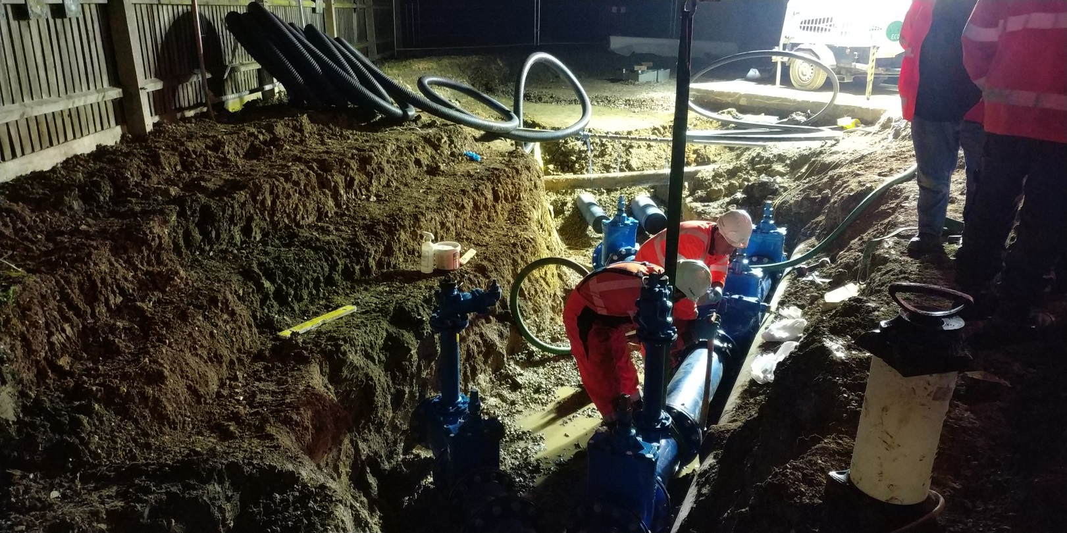
What does planned work look like?

Slide 11
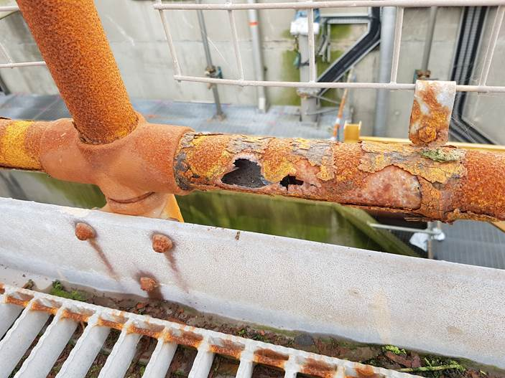
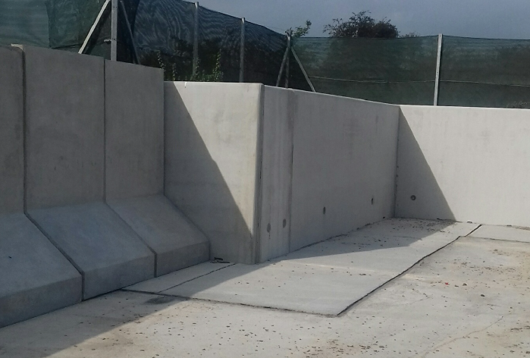
What does planned work look like?

Slide 12
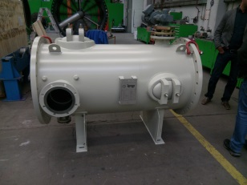


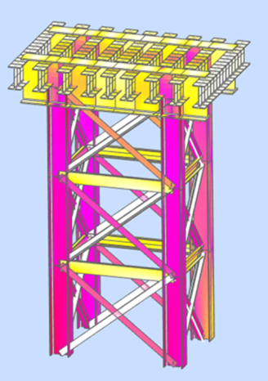
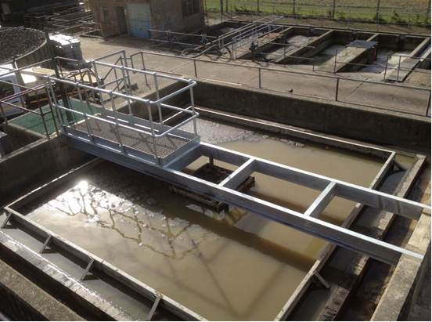
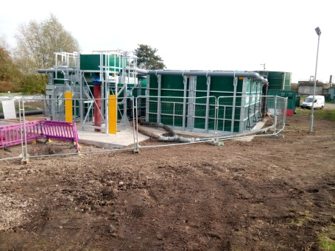
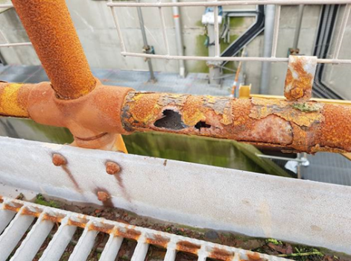
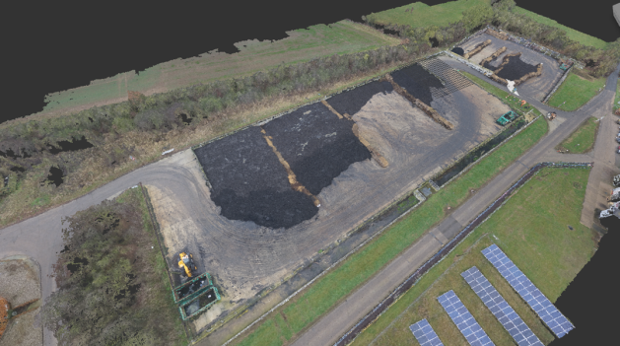
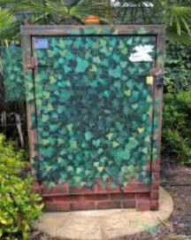
Repair, Replace, Enhance - IOS

Slide 13
Thank You

