Slide 1
Water Connect 2017 Integrated Maintenance & Repair Water Recycling

Slide 2
The IMR WR team
Steve Drake – IMR WR Delivery Manager
Andy Gibbons – Director, Claret Civil Engineering
Lee Freeman – Director, Public Sewer Services
Russell Fitzjohn – Operations Manager, Danaher and Walsh
Katy McNally – IMR WR Knowledge Manager

Slide 3
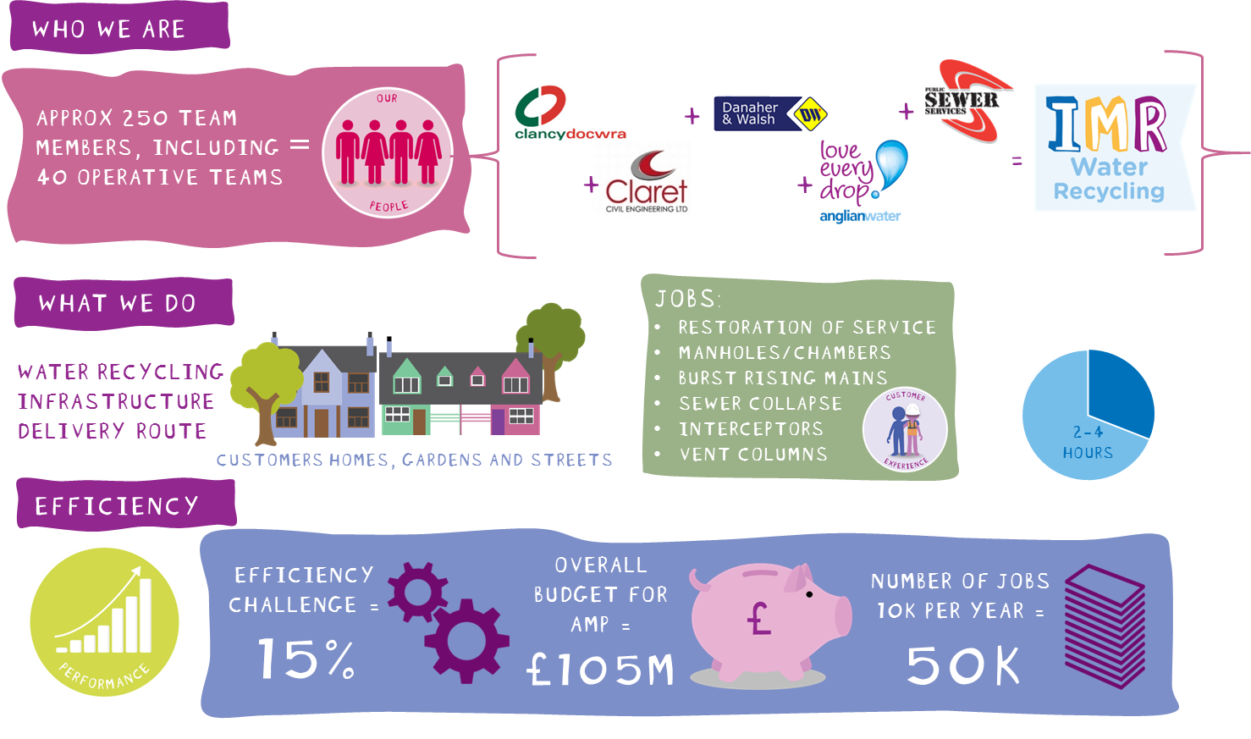

Slide 5
Our Aims and Objectives
Our People
We will develop an IMR WR family culture
Core to our success will be:
To be the Alliance of choice
To nurture positive behaviours
A work life balance for our people
Investment in our people
Recognition & reward for our people
Engagement with our communities & stakeholders
Diversity & Sustainability
We will adapt, to ensure that we are future proof
Core to our success will be:
Adapt to the changing nature of the work
Fair and sustainable profits
Prioritised and planned budgets
Identify and manage risk
To embrace innovation & competition
Customer Experience
We will have a robust SIM strategy
Core to our success will be:
Management of customer needs and expectations
Clear customer ownership
Use of customer’s preferred communication methods
End to end job visibility
First time fix
Collaboration & Integration
We will be efficient & effective through working and learning together
Core to our success will be:
Cross Partner & Alliance collaboration
Shared resources & logistics
Truly Integrated teams
Commercial Model integration
A common IT platform
Safety, Health, Environment and Quality
Provide a safe working environment
Core to our success will be:
Provide clear leadership and governance
Continually encourage our teams to be healthier, happier and safer
Continuation of our waste reduction initiatives
Further develop common approach to safety standards
Share Health, Safety & Environmental innovation within the business

Slide 6
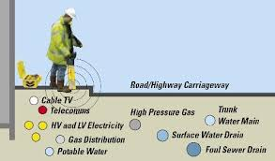
Areas for development
Less digging & confined space entry
Remove stubborn material
in sewers
Optimised Sewer Networks
Reduce
traffic disruption &
customer impact
Detect & mitigate against service strikes

Slide 7
Come and talk to us about
Sharing
utility information
Game-ification
Sharing resources
Amazon style
planning & delivery
Sustainable frameworks
& products

