Slide 1






Who are the IS alliances?
EWM – Enterprise Works Management
July 2016
EIM – Enterprise Information Management
October 2015
Notes:
The EIM Alliance was established in October 2015 and since that time has developed a company-wide vision and information charter that is aligned to Anglian Water’s business goals and customer outcomes. The team has developed supporting strategies for data management, content management, mobile, business intelligence, social & collaboration, and business process management. The alliance is currently implementing a roadmap of next generation EIM platforms, whilst working with the business to adopt the right level of information governance, new user centred design techniques, and modern agile delivery implementation methodologies. The EIM alliance is focused on improving the user experience of all stakeholders; unlocking value from within our existing and new information; being more digital and responsive to constant change; building a well-managed information source that is trusted and used by all; being a more effective organisation by making better decisions; and being a more efficient organisation by not wasting time and money through unnecessary searching, duplicating and recreating of information.
The EWM Alliance was established in July 2016 and is focussed on delivering key foundational and transformation programmes to support the delivery of business strategies and outcomes.
We are winning hearts and minds as we demonstrate how value can be gained by doing things in a different way. We are keen to work with individuals, small or large organisations from academia, charities, government and private companies. We are keen to learn from inside and outside of the water industry, and are ready for win-win collaboration with like-minded people who want to use innovation to solve real world problems for everyone in our community.
We really want to work with people who can apply technology innovation to solve problems that will add value to the Anglian Water community. Some of things we are currently interested in are:
machine learning algorithms to increase predictive and prescriptive decision making
robotic process automation to increase productivity
virtual & augmented reality to improve visualisation of information
sensor, IOT and telemetry data to improve product lifecycle management and customer service improvement
voice recognition, voice to text and natural language voice command to improve actionable analytical insight and improved user experience
shared and open data opportunities to promote customer self-serve and third party app development

Slide 2
The roles and objectives of the EWM and EIM alliances
EIM covers the delivery of enterprise information management initiatives (content, mobile, BI and data) to deliver Anglian Water’s information management vision.
Its objectives are to:
improve the user experience of all stakeholders;
unlock value from within existing and new information;
enable AW to become more digital and responsive to constant change;
build a well-managed information source that is trusted and used by all;
enable AW to become a more effective organisation by making better decisions;
enable AW to be a more efficient organisation by not wasting time and money through unnecessary searching, duplicating and recreating of information.
EWM EWM covers the remainder of the IS programme i.e. major upgrade and enhancement programmes such as data centre rationalisation, end user computing, customer experience transformation programme

Slide 3
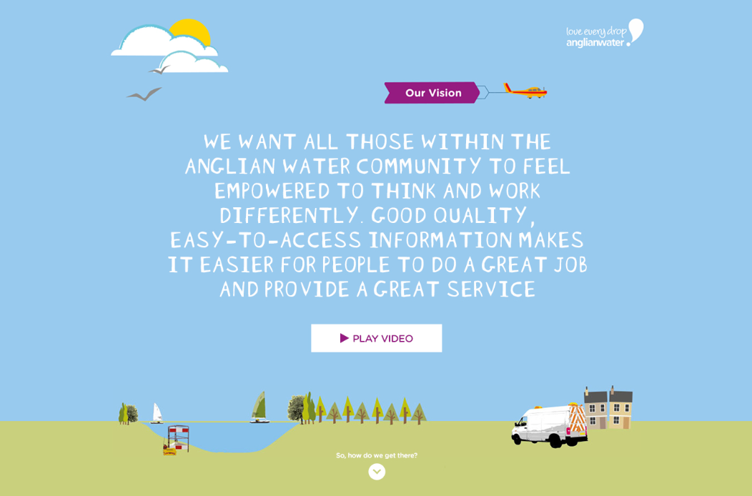


Slide 4
Information Management Roadmap

Slide 5

EIM Programme Areas
Enterprise architecture data model
Exploration
Business Process Management
Mobile
Business Intelligence
Social/Collaboration
End2End Apps
Content Management
Organisational Capability

Slide 6
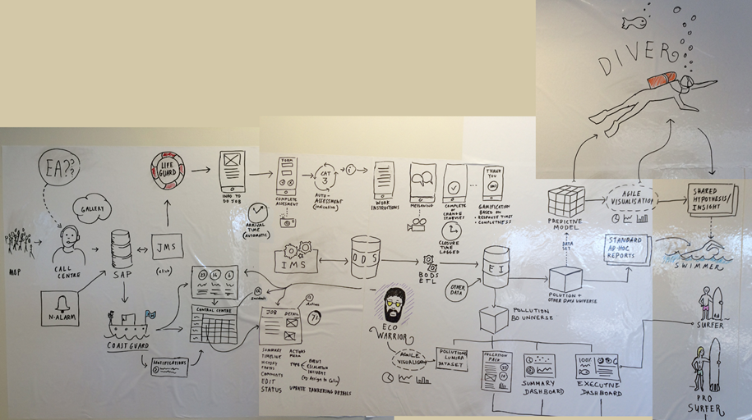
End2End Apps Example
1
4
2
3

Slide 7



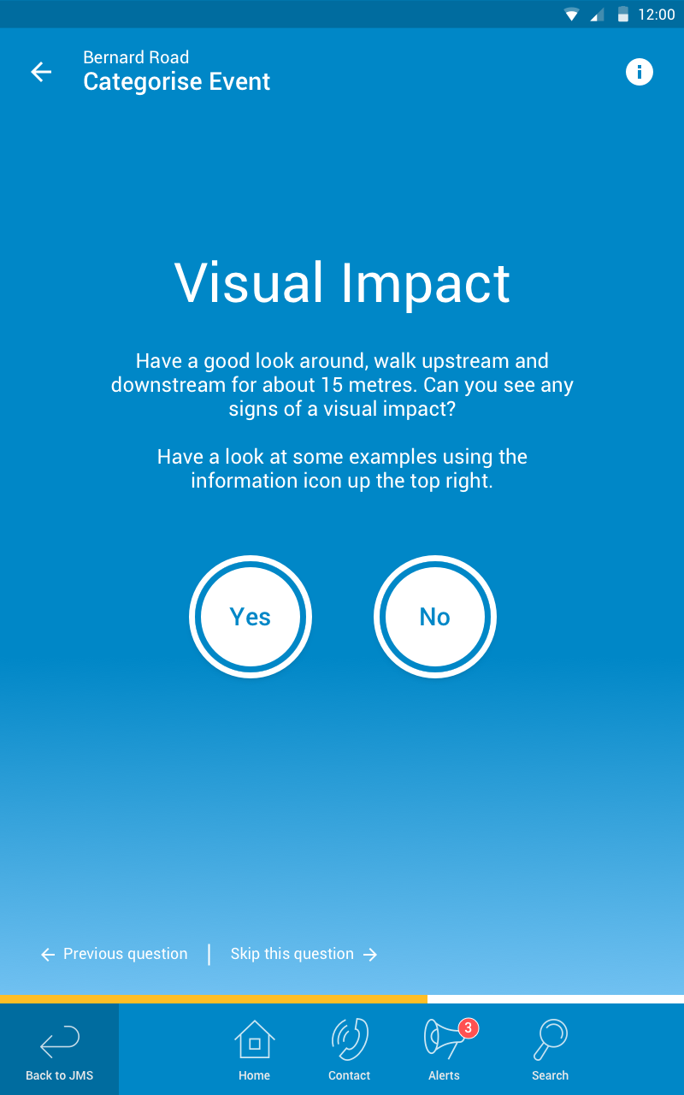
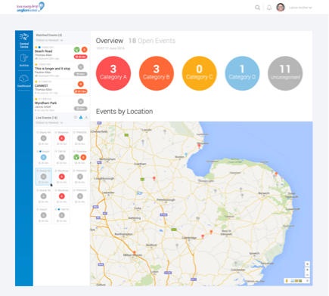
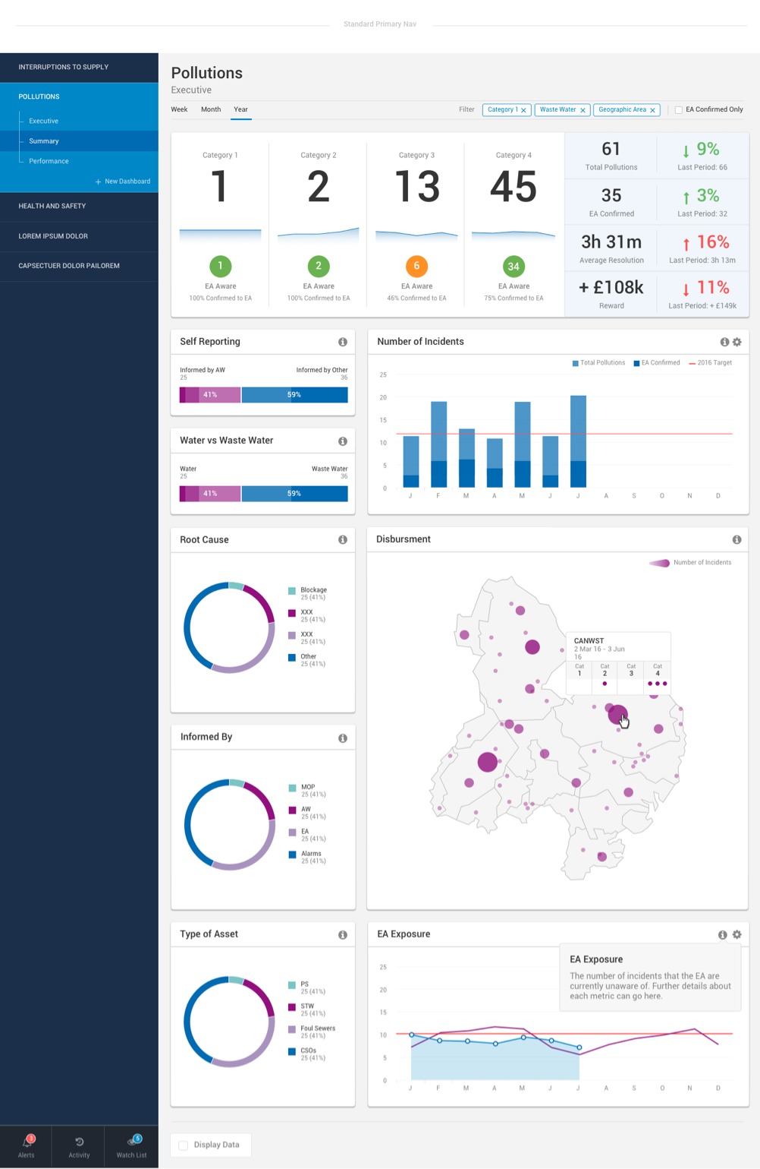
MOBILE APPLICATION
Provides field-based workers with access to people, process, systems and data to carry out their daily activities and enables easy data capture to support downstream processes
CONTROL CENTRE
Manage and coordinate the successful execution of daily activities carried by field-based workers
DASHBOARDS & REPORTING
At-a-glance monitor critical business process and track current performance in real time by key metrics. Gain an in-depth insight and attain static information reports to make informed decisions
MOBILE
APP
CONTROL CENTRE
DASHBOARDS
& REPORTING
FT
DM
Wider Business
REAL-TIME INFORMATION

Slide 8
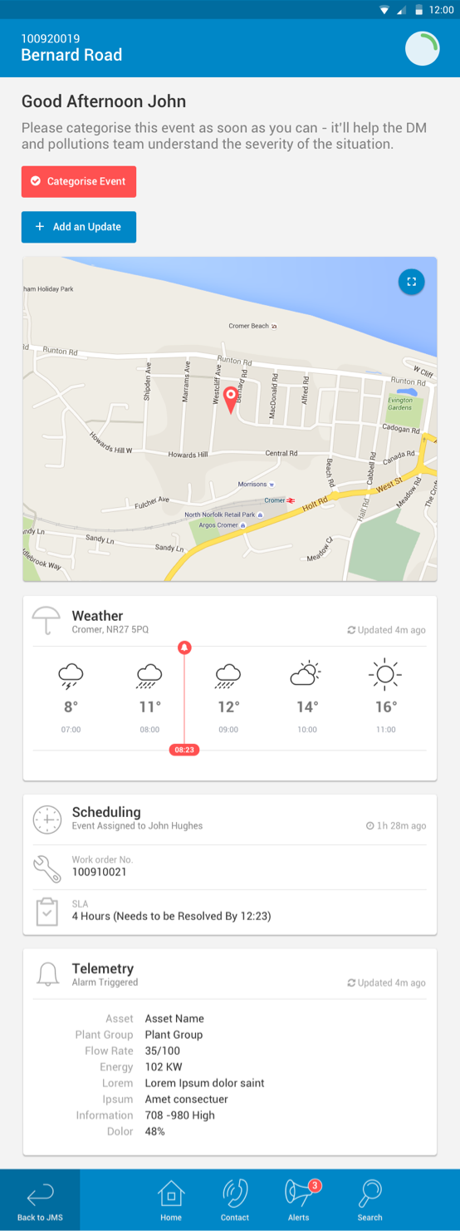
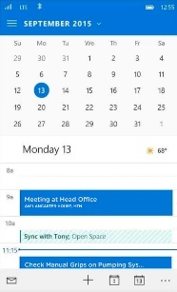
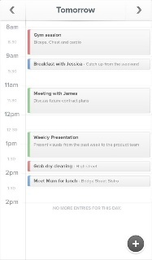
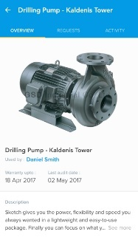
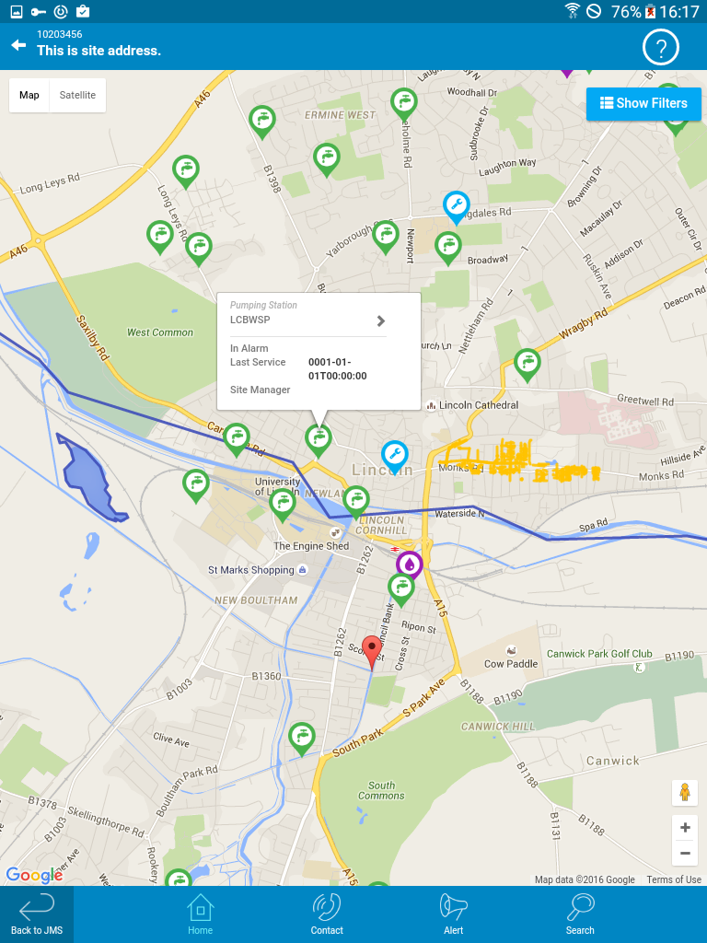
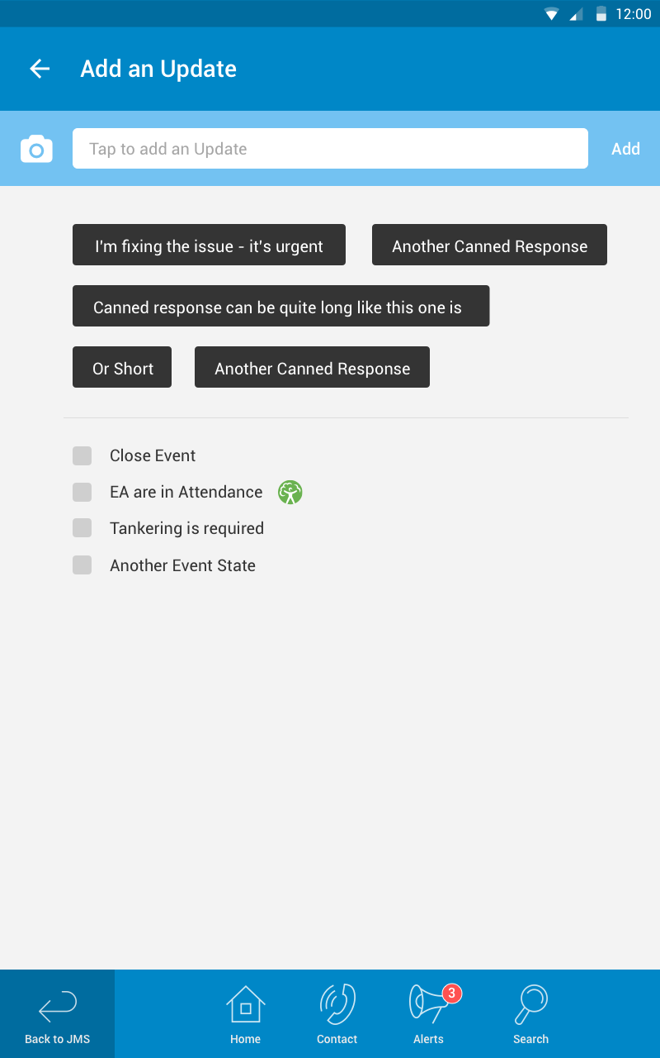
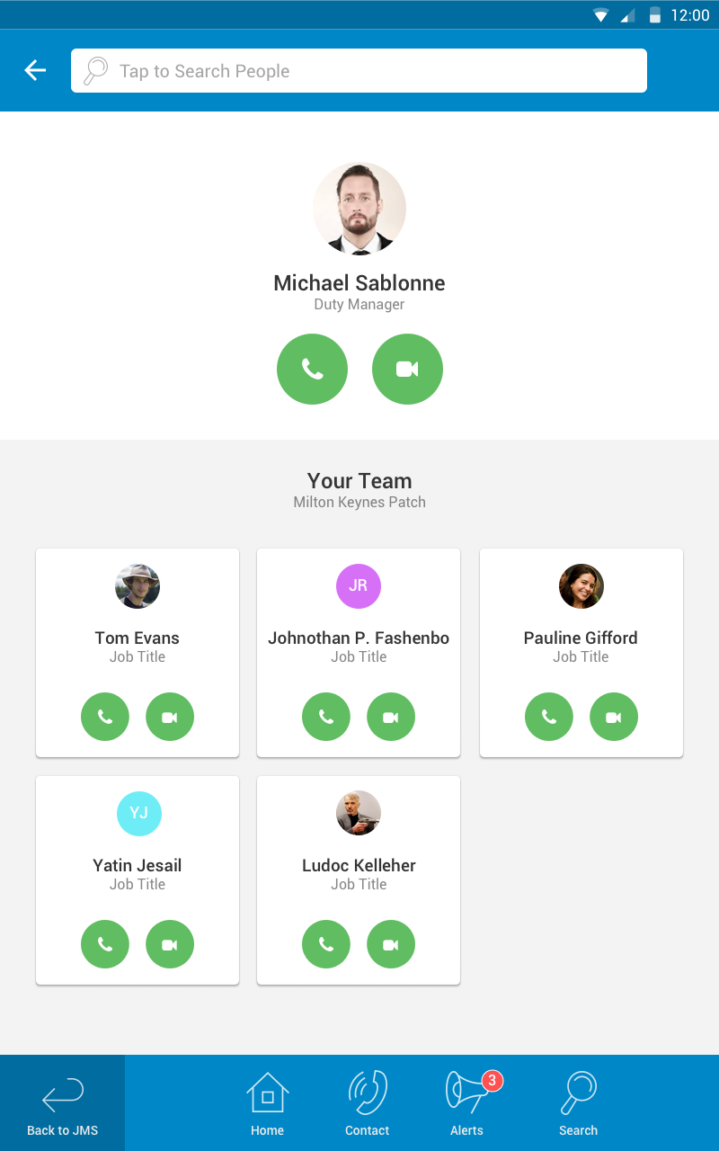
Mobile App
The Field service mobile app present field technicians with an intuitive mobile app for end to end field service process. Where user can capture and send information to a back-office application accessible to operations team.
Calendar & Daily Schedule
Work Schedule
Categorise Event - Wizard
Asset Information
Improve Communication
Access work orders & job details
Send/receive real time updates
Data capture & data transfer to back office operations
Easily collaborate with all people who are part of the workflow
Access job information
Quick & simple Question based assessment captures key information
Asset detail feeds
Asset feedback forms
More….
Automatic Arrival Notification to DM
Time Vs SLA Indicator to track progress
Access to back office systems e.g. telemetry info
Weather status to support decisions
Capture real-time Event update- comments & images
Map View & Directions
Add Update
to Event Feed
Make Voice / Video Calls
Route optimisation travel times, distances between depots
Considers barriers (e.g. Traffic)

Slide 9
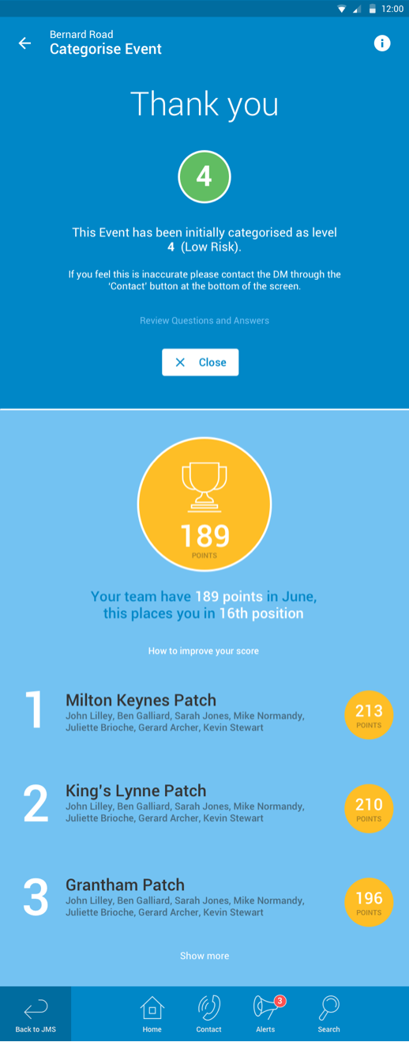
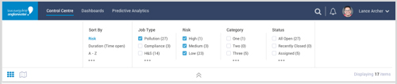
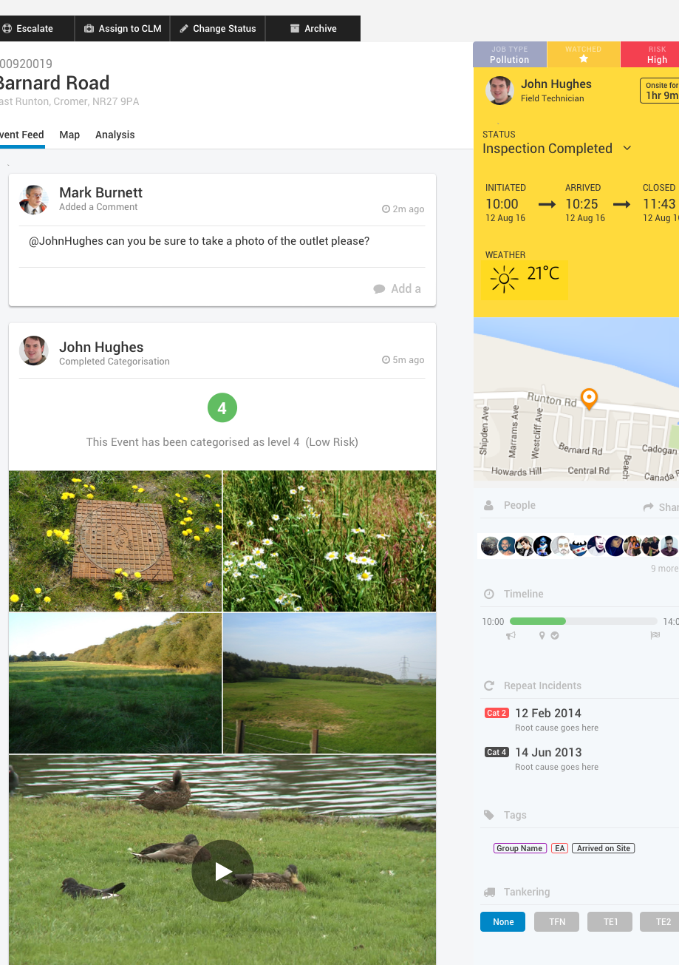
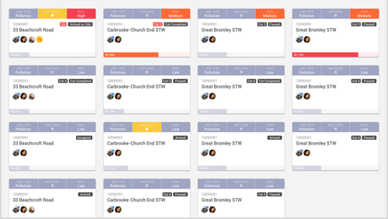
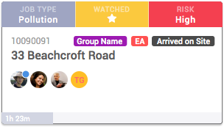
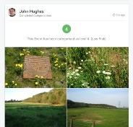
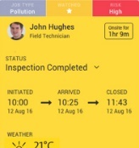
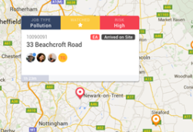
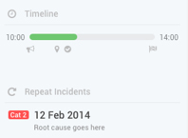
Control Centre
Monitor and track the day to day events, communicating with Field-based team to manage and coordinate daily operational activities
Linking from Mobile App
Dashboard Filtering
DM’s View of Event Feed
Improved Visibility
Efficiently Manage Multiple Events with real-time feeds from field-based mobile App
Live event status feeds– interactions/ dialogs, comments and images (inc. event historical)
Send and receive alerts on the status events. Tracking them till closure
Filter on events (e.g. high priority)
Map view of Events
Summarised view of Event
Live Event Feed Dashboard
Event Card with Priority Indicators
Live Feed
Summary
Interactive Map
Timeline & Past Incidents

Slide 10
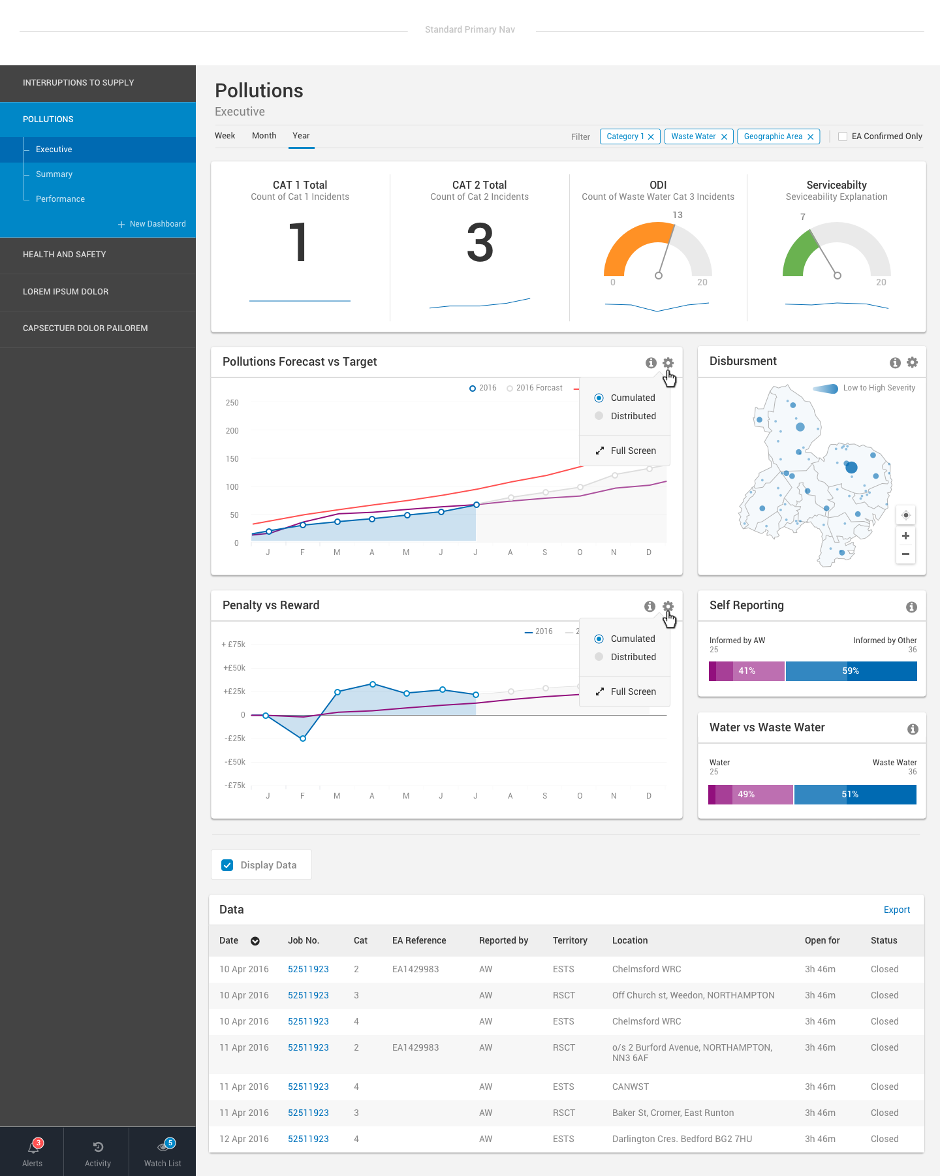
Dashboards
& Reporting
Gain an insight into your performance against key business measures. A summary of key performance metrics that can inform and drive incremental improvements
Executive Dashboard
Summary Dashboard
Impact Disbursement
Asset Health Check & Analysis
Business Intelligence
Visual presentation of performance measures
Filtering and drill down through various performance data via tags and time periods
Generate detailed reports showing new trends
Changing data interpretation and visualisation, i.e.. Bar Graphs, Line Graphs etc.
Real-time data updates, from the field
Complete view of broad & specific operational costs
Asset / operation health check
Gain broad insight into total impact of operations
Regional performance highlights
Showing key state
Health check
Incidents Over a Specific Period
Drillable Visualisations
Real-time Data Capturing & Reporting

Slide 11








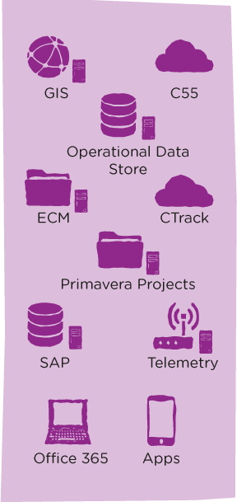






How the EIM components fit together
The physical world is accurately reflected in data and content that is stored in our corporate systems
Business
Operational Systems
Business Intelligence and Mobile Platform
Enterprise Architecture Data Model
Use Case
Business
Workers use corporate systems to perform their work.
They capture, create and process information.
Robots used to automate business processes
Data science exploration platform
Prove Theory
Subject Matter Experts
Information model
Metadata
Master data
Data quality
Planners
Modellers Insight Team
Program Office
Complex Analytics
Self Service Production Data Warehouse
Visualisation
Ops Support
Knowledge Workers
Project Office
Simple Analytics
Find & Use
Workers
Mobile
Use
End2End Apps
Identify root cause issues and fix at source

Slide 12


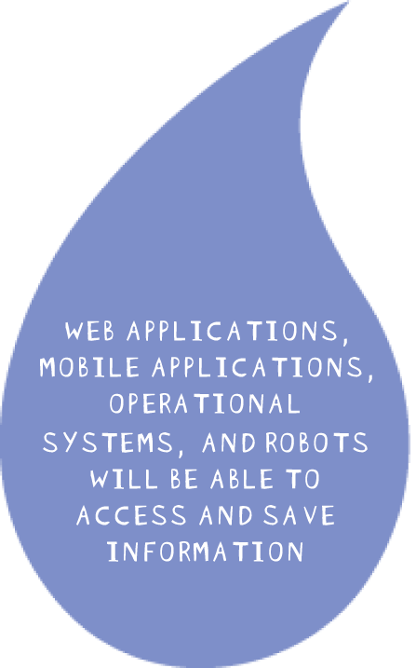


Information Service
STAKEHOLDERS CAN EXPERIMENT: PROVING HYPOTHESIS AND BUILDING PREDICTIVE MODELS

Slide 13
Where we would welcome input
Enterprise architecture data model
Exploration
Business Process Management
Mobile
Business Intelligence
Social/Collaboration
End2End Apps
Content Management
Organisational Capability

