Slide 1

Water Connect 2019
12th February

Slide 2
Welcome!
FIRE EXITS
TOILETS
MOBILE PHONES
WORKSHOPS
A – Phosphorous (Carey Suite)
B – Strategic Grid (Carmichael Suite)
Kingsgate wifi:
AWR
Wifi password:
waterconnect
Glisser:
glst.it/connect1202
Notes:
Ask AW attendees to stand up so that people are aware of who to speak to.
The morning session is focussed on sharing our challenges and the opportunities with you, please do not push your solution during conversations this morning.
During the afternoon and over lunch, we can start to explore specific solutions you may be able to offer or develop.

Slide 3
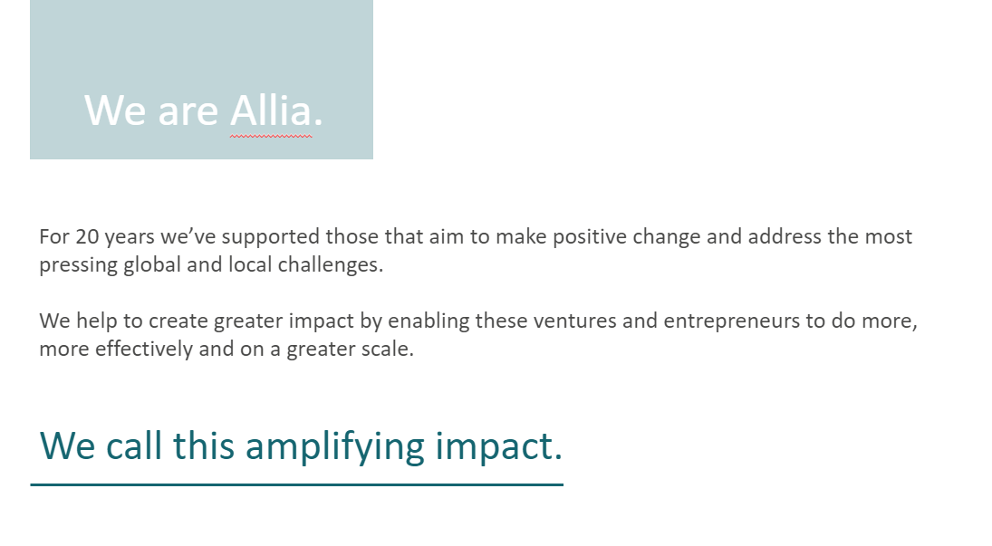
Notes:
I just wanted to take the opportunity to introduce Allia to those of you who might not be familiar with us. And to perhaps clarify why we see the Water Innovation Network being such a core part of our work and mission.
We specifically use our resources and activity to help those who are working – agnostic of business model – to address some of the big global challenges encapsulated through the UN Sustainable Development Goals. Amongst the goals are clean water and sanitation, climate action, sustainable cities and communities and responsible consumption and production. And we believe that WIN and events like Water Connect can be exciting launchpads for new thinking and innovation in this space.
WIN is part of our wider enterprise support activities which we deliver from a network of Allia Future Business Centres – both here in Peterborough but also in Cambridge and London. This year we celebrate 20 years and
Through our work, we’ve helped
Over 1,600 ventures​ to start up, grow and scale-up which have launched new innovations and companies creating
Nearly 4,640 jobs
And we have issued bonds that have raised ​
Over £330 million ​to help impact ventures with development projects and activities.
We look forward to being able to support ideas, individuals and innovations who can continue to create positive impact for people, planet and place.
I hope you enjoy the day and find it inspiring and full of opportunity.

Slide 4


In 2025…
100billion
…connected devices to the IoE
1 in 6
…of all car sales will be electric
China overtakes USA as World’s largest economy
8bn
6year anniversary
…UK celebrates
of leaving the European Union
…world population

Slide 5



…we have invested
In 2025…
30%
more since 2020 than during 2015-2020
…we have over
3million
homes connected to our network
Totex budgets by price control (£m)
56%
13%
55%
…of recycled water has been harvested for phosphorus
…of our water is lost in leaks - among the least in the world
…of our customers have hourly reads (highest in the UK)

Slide 6
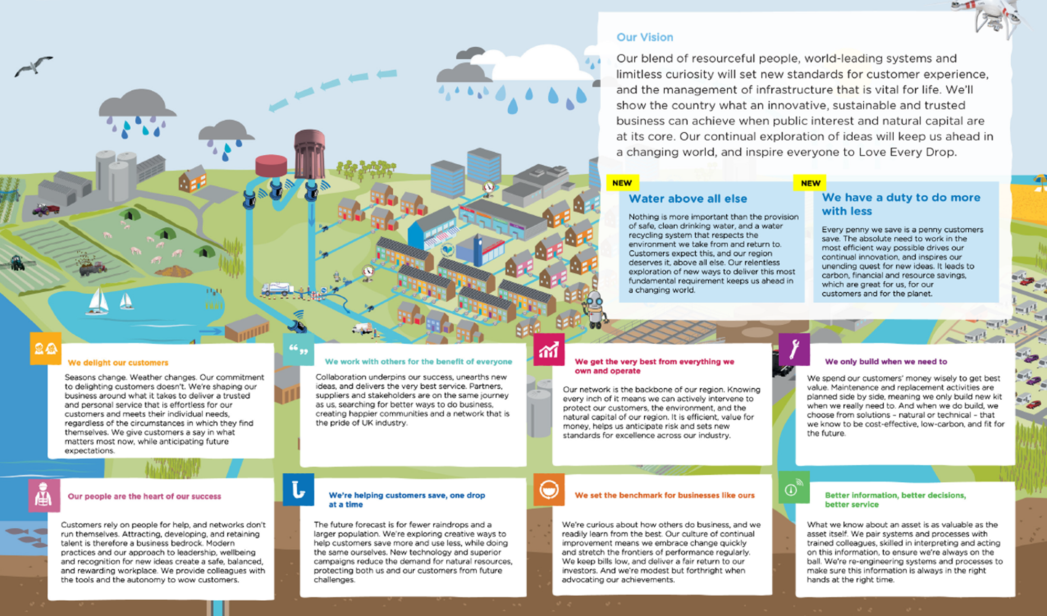

Our Asset & Operations Strategy
Point 1

Slide 7

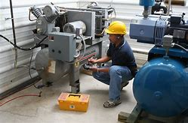
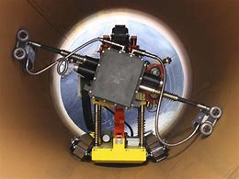

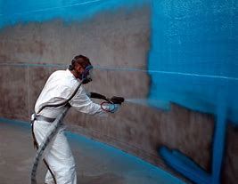
We get the very best out of everything we own and operate
~90% of the assets we will own in 2030 exist already
Innovation that can support us getting the best out of everything we already own is critical for us to achieve our outcomes
Smart tech, re-lifing tech, maintenance enhancements etc
The best of new, applied to the old!
MAKE DO AND MEND V2.0

Slide 8
We will work with others for the benefit of everyone
The challenges we face are not unique to us, yet we often address them alone
The opportunity to share solutions within our region, delivering benefits to our collective customers is there for the taking
Data, information, technology solutions that share a platform, possibly even the data itself
Collaboration and partnerships to unlock shared value to our customers

Slide 9
Better information, better decisions, better service
Data and information we have about our assets is just as valuable as the assets themselves
We will invest in the people, processes and technology we need to retain and refine it
Focussed on enabling key value decisions

Slide 10
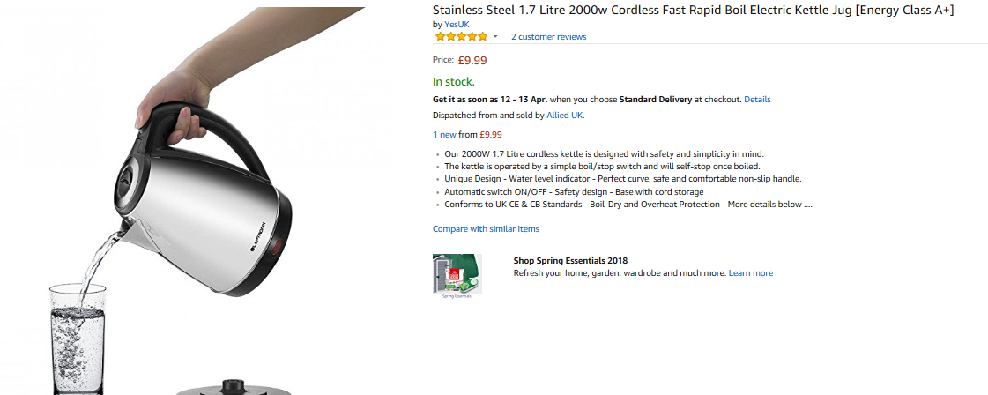
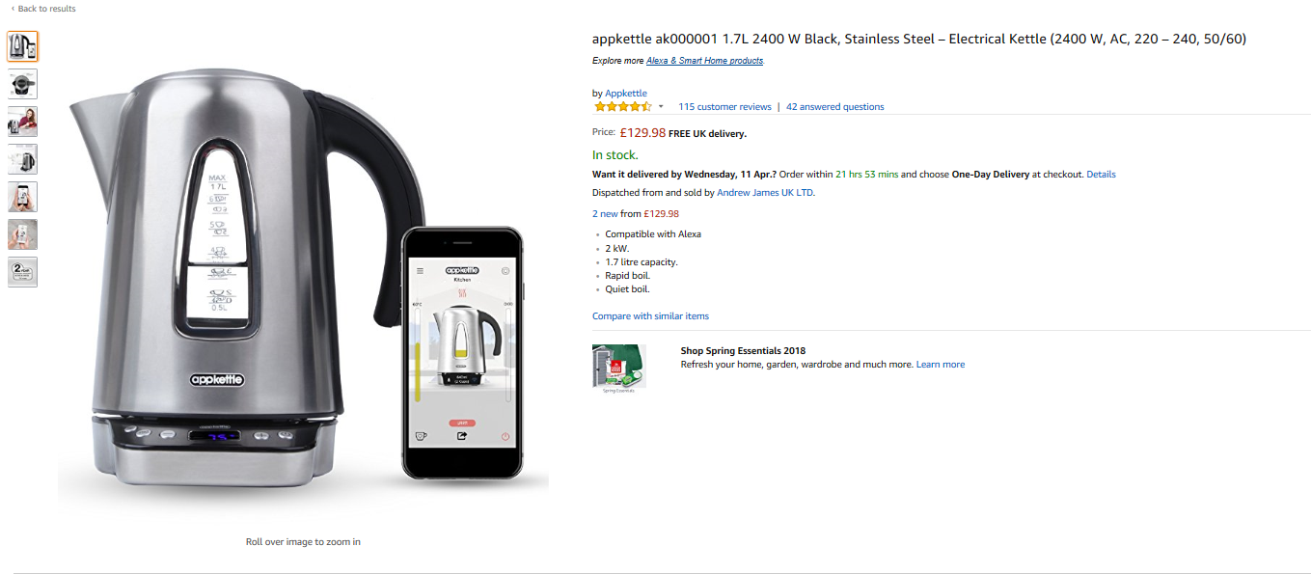
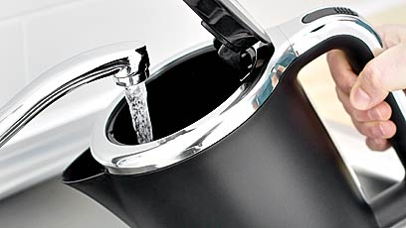
Smart

Slide 11
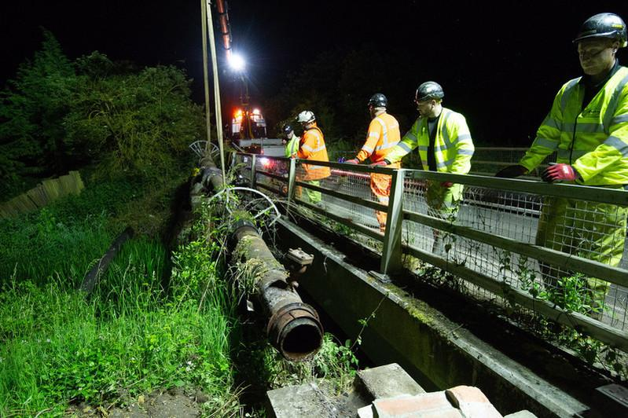
What is the purpose of a leading supply chain in the Water Industry?
Operations & Maintenance
Capital Delivery
Right Protection
Supply Chain & Logistics
Right Skills
Right Materials
Right Team
Right Equipment
Project
Right Time
Right Prices
Right Location
Right Service Providers
Right Service Levels

Slide 12
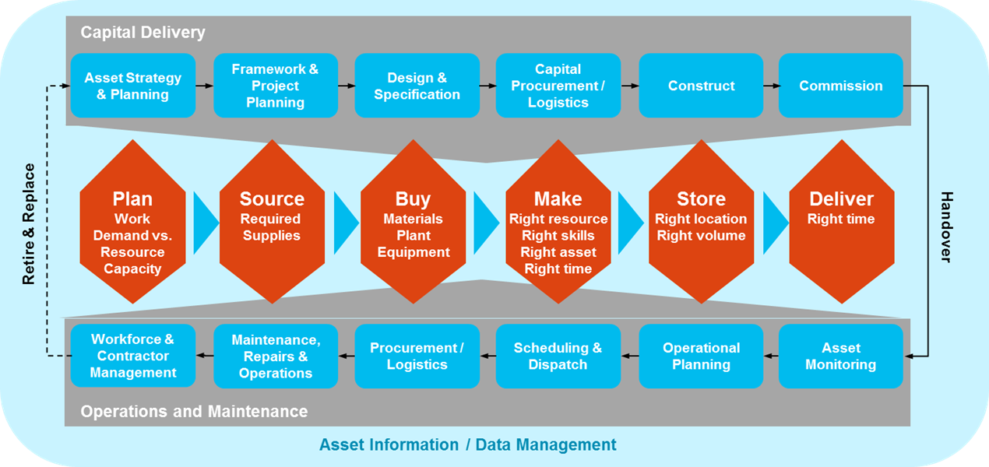
In our industry, Supply Chain primarily serves our underground infrastructure and key assets above ground

Slide 13
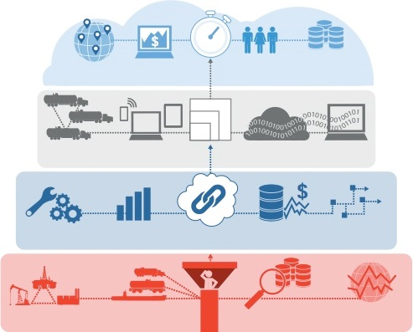
Digital technology will be key to drive efficiency and cost reduction in the Supply Chain…
Rapid
Enhanced responsiveness
Proactive prevention
Last mile postponement
Demand Sensing
Automated
KPI Reporting
Customer Service Infrastructure
Dynamic
Inventory and Replenishment
Scalable
Maximum efficiency
Organizational flexibility
Personalised experiences
Supplier Networks
Omni – Channel Enablement
Cloud Hosted Optimisation Tools
Digital Data Movement
Intelligent
Actionable insights
Automated execution
Enhanced, accelerated innovation
Predictive Maintenance
Predictive Forecasting
Integrated Optimisation
Supply and Price Analytics
“What-if “
Scenario Analysis
Connected
Real time visibility
Seamless collaboration
Highly evolved operating models
Connected Infrastructure
Transportation Control Tower
Traceability
External Data Exploitation

Slide 14
We are beginning our journey towards a Digital Supply Chain
Main Digital Supply Chain capabilities
VISIONARY
Advanced Demand sensing
TOMORROW
Plan
Cost to serve optimization
Rapid response scenario planning
ADVANCED
Virtual Company Mall
Multi echelon Inventory optimization
Machine to machine
Source
Virtual Supplier Room
Collaborative robot
MATURE
Performance Improvement Control Tower
Virtual Category Room
Virtual Manufacturing
UBER for transport
Spend analytics & contract compliance
Predictive Asset Maintenance (PAM)
Make
3D Printing
Integrated planning
Cloud based Supplier collaboration
Connected Worker
Manufacturing Control Tower
BASIC CAPABILITIES
Automated source-to-pay in cloud
RFID
Self driving trucks
Advanced Planning and Scheduling (APS)
Deliver
Inventory & Warehouse Management
Dynamic Network Optimization
Transport Analytics
People Logistics
Management
Fulfilment Real-time visibility
NOW
Automated Transport Planning
Transport Control Tower

Slide 15
























Our aim is to turn our field service workers into ‘Digitally-enabled Workers’ within the next 10 years
Software
Displays
Hardware
Scheduling & Dispatching
Social Collaboration
Glasses
Tablets
Gloves
Drones
Mobile & Wearable Software Platforms
Gamification
Watches
Phones
Clothing
Robotics
Video & Immersive VR Learning
Smart Operating Procedures
3D Printing
IoT
Digital Assistant
Augmented & Mixed Reality
Smart Sensors
Connected Assets
Cameras

Slide 16
What are we doing right now to prepare for AMP7?
Integrated Materials & Logistics Management
Technology Requirements
Delivery Requirements
Storage Requirements
Management Requirements
Management of Change
Single Cloud-based WMS for all users (incl. Alliances)
Real-time stock visibility on-the-go
Improved reporting capabilities
Visibility through receipt to dispatch
Asset tracking from receipt, dispatch and job completion
Just in Time
Multiple supply channels
Increased frequency of deliveries
I2S Immediate response
Improved vehicle utilisation
Reduction in overall transportation costs
Multi User RDC’s
Capacity to perform value-add services
Defined warehouse processes
MIC Standards maintained
Return Logistics
Logistics Control Tower
SLAs / KPIs reporting
Quality management
Active supplier performance and closed-loop management
Driving benefits for all delivery routes
Ensure new processes and ‘ways of working’ are adopted by the business

Slide 17

Integrated Supply Chain Operating Model
Visibility across Planning & Fulfilment
Integrated control towers and/or centres of excellence (CoE) drive cross-functional collaboration and decision making.
3 layers of capabilities across the entire supply chain
1
2
3
4
DRIVE
An integrated framework providing real-time visibility, root cause analytics enabling rapid response and continuously improving process execution
A set of capabilities that seek to combat rising volatility, complexity and uncertainty
An integration
of supply chain processes and tools across silos (enhanced collaboration)
A focused approach
to deliver a specific set of business outcomes – targeting improvements in costs, inventory, quality, customer service and assets utilization
Visibility, Planning & Execution

Slide 18

Integrated Supply Chain Operating Model
Visibility across Planning & Fulfilment
L3 Execution
Process Execution
Demand & Supply Planning
Let’s make it happen.
Disseminating Information & Action Plans
Monitoring Execution Compliance
Continuous Improvement
Control Tower
Deployment & Transportation
Customer Service
& Work Management
L2 Analytics
Root-Cause. Intelligence and Rapid Response
Why is this happening?
What could happen next?
How to improve?
Process and Analytics COE
Root-Cause Analysis
Simulations, What if Scenarios
Risk Analysis
& Response Management
L1 Visibility
Real–Time Visibility
Artificial Intelligence
Why is this happening now ?
Dashboards
Alarms Generation
Telematics
B2B Integration
Cloud
Materials Inventory, orders, shipments
FG Inventory, forecasts, shipments
Analytics
Mobile
Social Media

